Slide 1
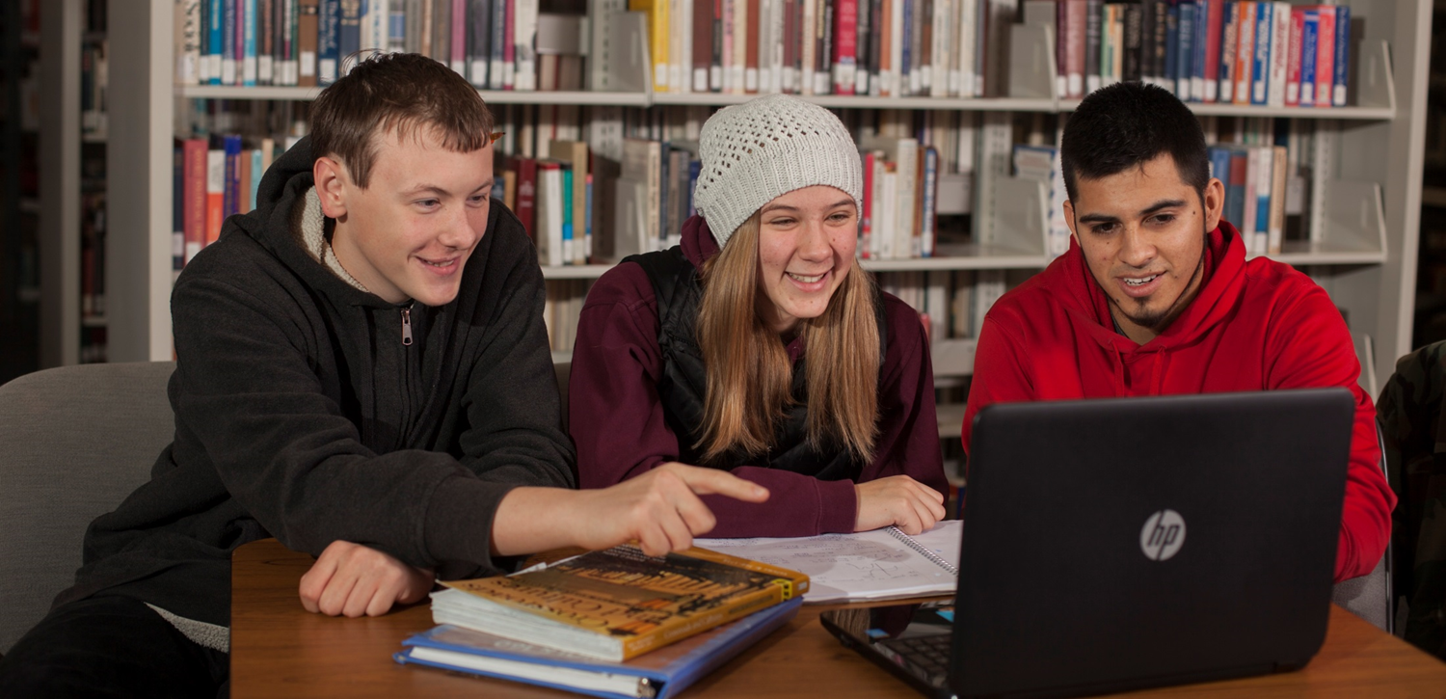
Health Sciences Library Orientation
Ying Yu
Last updated: 1/4/2024

Slide 2
You are here, yay!
Main Goal: You wouldn't hesitate to contact me in the future.
Goal 2: Know what resources are available

Slide 3
Session Objectives -1 (Tech)
Login to a CBC computer
Connect to CBC-WIFI
Print using the NetPrint system
Reserve a study room
Notes:
After the 30 minutes session, students should be able to

Slide 4
Session Objectives -2 (Research)
Find library websites
Locate the list of HS databases
Chat with a Librarian
Try a simple search in Nursing Reference Center
Notes:
After the 30 minutes session, students should be able to

Slide 5
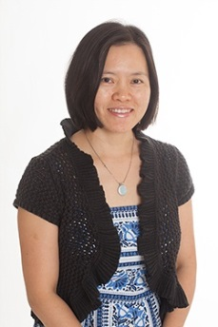
Introduction
Ying Yu
Liaison librarian to
School of Health Sciences
School of Education
Email me directly: yyu@columbiabasin.edu
Or email me through Canvas
Notes:
Please feel free to email me directly using my email address or email me through Canvas. I got my master's degree in Library and Information Science from University of Illinois in 2002 and I worked at CBC as a faculty for a very long time and really enjoy helping students as a librarian.

Slide 6
We are here for you!
Library student workers
IT support (Richland):
Jeff (509-544-4929)
Librarians and staff in Pasco on call

Slide 7
Health Sciences Library Hours
Monday – Thursday:
7:30 am to 4:00 pm
Friday:
7:30 am to noon

Slide 8
Main Library (Pasco) Hours
Monday – Thursday:
07:00 am to 7:30 pm
Friday: 07:00 am to 4 pm
Saturday: 11:00 am to 4 pm

Slide 9
General Use Guidelines
Cell Phones
Please be thoughtful of others, take your phone calls outside
Food and Drink
Covered drinks and food are allowed in the library. Leave No Trace. Clean up spills right away -- Notify the staff for assistance.

Slide 10
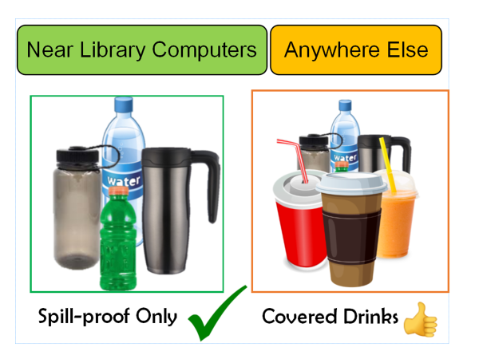

Slide 11
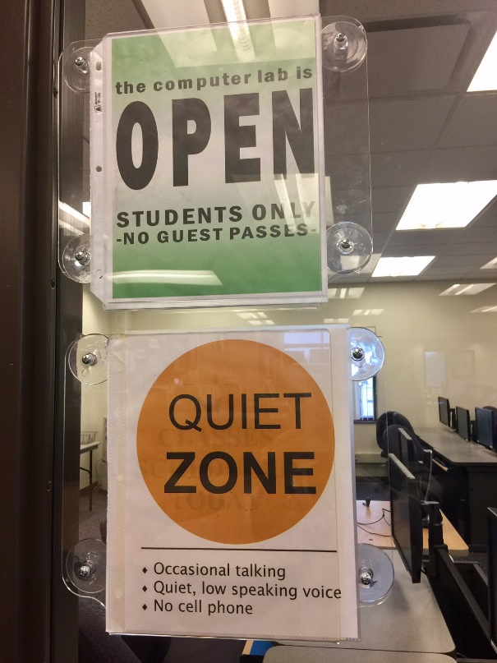
Computer Lab (HS308)
30 computers in the lab
Open most of the time (check sign)
Quiet Zone
Printer in the lab is
G1124

Slide 12
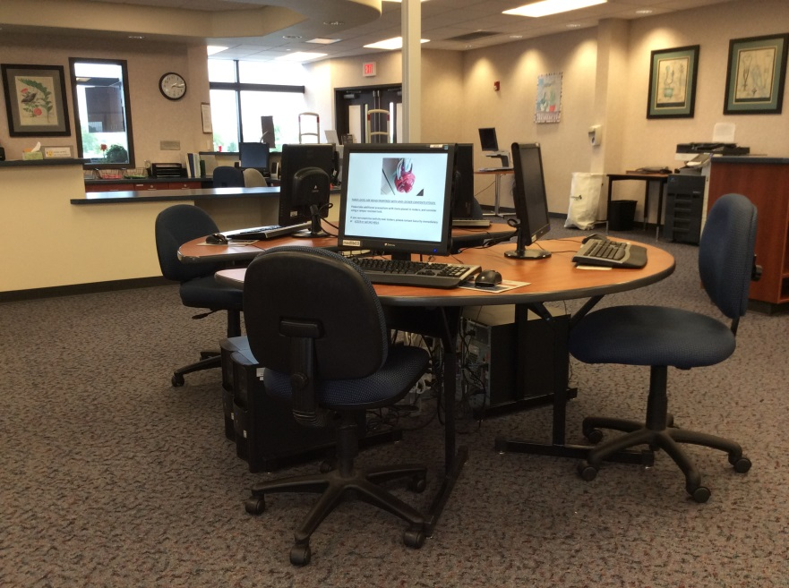
Library Open Area
14 computers
Firefox ☺
Chrome

Slide 13
Computer Login
Login: Student Email Username
firstnitiallastname# (e.g. rsmith2)
You do NOT need to add the full email address @students.columbiabasin.edu
Password: Your Email Password

Slide 14
Remember to Log Off
Click on the Windows icon:
Click on your photo
Choose “Sign out”

Slide 15
EXPIRED PASSWORD
Change it on a CBC computer when prompted
New password needs to be complex enough and not the same as any previously used ones
Write down your new password!!!
This is your new password for Canvas, Wifi, and email!

Slide 16
Columbia Basin College NetPrint System
Use your own laptop or a CBC computer
Login to NetPrint
$12 credit/quarter; 400 pages in b & w
If needed, buy $3.00 cards at library front desk on both campuses
Notes:
$12 equals to about 400 pages black and white at 3 cents per page/side, default double-sided. Color is 9 cents per page, default single-sided.

Slide 17
CONNECT TO CBC-WIFI
Do NOT choose the guest WIFI (slower; does not work for Canvas; can’t connect to NetPrint)
Choose “CBC-WIFI”
Username: CBC student email username only
Password: student email password
See detailed Instructions

Slide 18
Links to NetPrint
https://www.Columbiabasin.edu/netprint
Click on the “Netprint link” at the top
Bookmark the link for quick access later http://netprint.columbiabasin.edu:9191/
(This link only works when you are on campus and connected to “CBC-Wifi”)

Slide 19
HSC Printers
G1111 (library Main Area)
G1124 (library computer Lab)
G1157 (Color) (library front door)
G1174 (HSC 1st floor lounge)

Slide 20
Printing
Only NetPrint Web Print is available now on the Richland campus
You can NOT click on ‘file”, “print”, and directly choose a printer
You have to login to NetPrint and then upload a file to print

Slide 21
NetPrint Login
Username: CBC student email username only
Password: student email password

Slide 22
Print PPTs with NetPrint
Click File-Print and choose the printer option “Microsoft Print to PDF”.
Select “3 Slides” or “6 Slides” per page
Save the PPT file as PDF in a location (e.g. Documents, or Downloads) for uploading later.
Or Save a PowerPoint as an XPS file

Slide 23
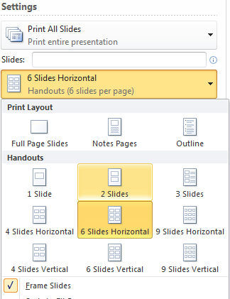

Slide 24
NetPrint- Web Print
Step by step instructions for Web Print
Once in the NetPrint system, click on “Web Print” on the left side menu and then follow the directions to upload the file to the system to print. Click on the green buttons in each step.
After the file has been sent to the print server, you will see “Rendering print job” message as it works.
Click “Held in a queue”
Click “Print”

Slide 25
NetPrint – More Notes
Black & white printers print double -sided
Files more than 50 pages may not upload
Test one file first and pick up promptly
Notify library staff or IT help desk if out of paper/Jam

Slide 26
Help Desk
Jeff (Richland campus) 509-544-4929
509-543-1445 Student Help Desk
shelp@columbiabasin.edu
(For advanced tech support or remote help)

Slide 27
List of things the help desk can help with.
Notes:
One of the things the Help desk can help with is Office 365. As a current CBC student, you can download Office for free to your laptop and if you have trouble doing that, you can give them a call.

Slide 28
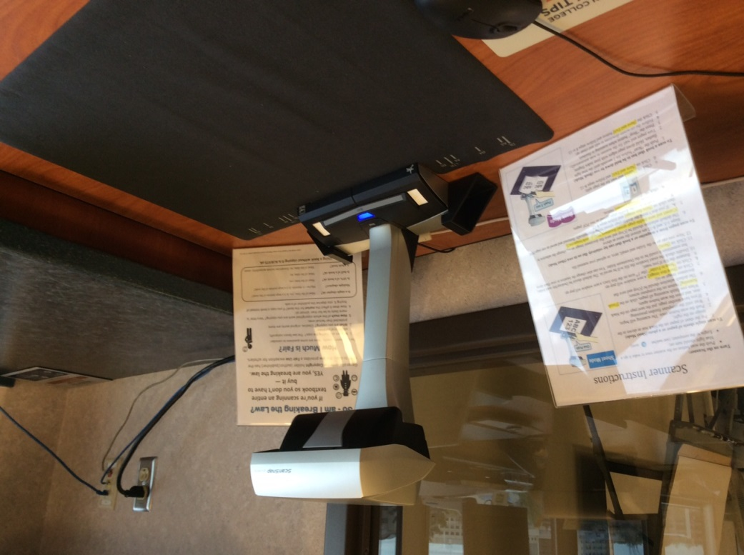
Scanner
Connected to medlib05
Instructions posted
Ask staff for help

Slide 29
Scanning Apps
IOS: Scannable
Android: Google Drive
(Instructions)
Notes:
A couple of scanning apps that I have found to be user friendly.

Slide 30
Copy Machine
Duplexes
Autofeed
Can scan to USB drive

Slide 31
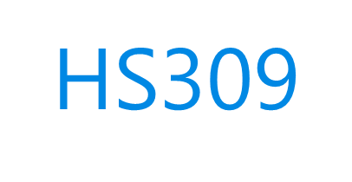
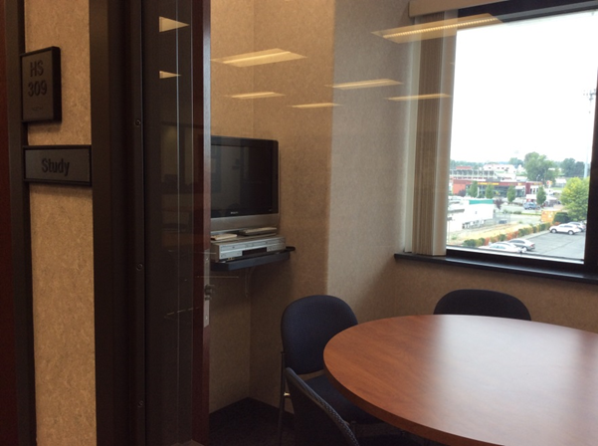
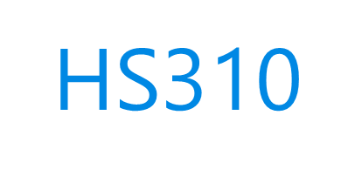
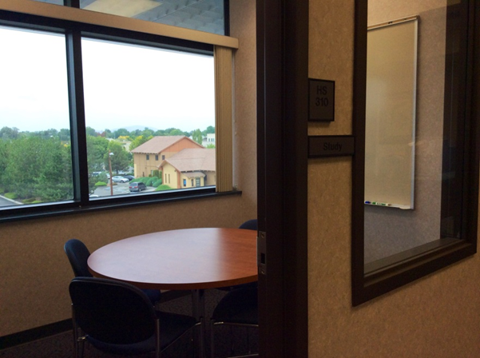
Study Rooms
Check in at the front desk
Reserve on the HS library website
Reserve a Room!
Or use link: https://bit.ly/CBClibrooms
Two-hour blocks
Second monitor in HS310
Not soundproof

Slide 34
Other Resources
Ask at the Front Desk for:
Headphones
Calculators
Thumb drives
Laptop charger

Slide 35
Laptops
FAQ: How do I borrow/return a laptop?
Ask at the front desks
One month loan
Need your photo ID and
CBC student email address and password

Slide 36
Books and Journals
Reference Collection (Use in the library)
Circulating Collection (Check out for 2 weeks)
Purchase suggestions welcome
From library website: Submit a Request
Some Journals in print (More online)

Slide 37
Online Request Form
Notes:
The link can be found on the mail library home page.

Slide 38
Library Websites
Main Library Homepage
columbiabasin.edu/library
Health Sciences Library Website
columbiabasin.edu/hslibrary

Slide 39
The main library building in Pasco is renovated and open for business!
Notes:
The quickest way to go to the library’s homepage is by using the Quick Links on the right side of the CBC homepage.

Slide 40
The OneSearch search box has a blue outline. It contains most of the databases that CBC subscribes to.

Slide 41
The Health Sciences OneSearch search box has a green outline. It searches a smaller number of databases with a Health Sciences focus.
Notes:
So when you use Health Sciences OneSearch, you will get less results, but hopefully more relevant to allied health. They have pro and cons. Sometimes you want to use a bigger database because you might want to have a broader number of results.

Slide 42
Individual Databases
You can also search specific databases like CINAHL or Nursing Reference Center or PrepStep for Colleges individually.

Slide 43
Library Databases
OneSearch or
Health Sciences OneSearch?
CINAHL and Nursing Reference Center
Everything available from home
Login with Student email username and password

Slide 44
Chat with a Librarian
Access from the library homepage
Login first with your Student ID
CBC librarians can instant Zoom through Chat
Research consultation appointments are also available
Notes:
A human (librarian) actually will answer you, even in the middle of the night because this is a collaborative service that we joined with other librarians throughout the world. /sometimes you might be getting help from a librarian in Bellevue College. You might get help on how to find a reputable website from a librarian in Hong Kong. You might get help on how to use a better keyword to do your search from a librarian from the United Kingdom. If they can't answer a question that's pretty local, a CBC librarian will follow up by email.

Slide 45
Library Chat Hours
Chat monitored by a CBC librarian
Mon. to Thu.: 8 am to 4 pm
Friday: 8 am to noon
Chat is also available 24/7
backup non-CBC librarians
Notes:
I encourage you to use the “Chat with a Librarian” service. A CBC librarian staffs the chat Monday-Thursday from 8am to 4pm and on Fridays, from 8am to noon. Outside of those hours, a backup librarian from another college will answer your chat question 24/7. A CBC librarian will also review after hours chat transcript and follow up with you though email as needed.

Slide 46
Notes:
Another source of information and tutorials is the Health Sciences Library course that I created in Canvas. It's an open course, which means anyone has the link can go there and look at the information.

Slide 47
Health Sciences Library in Canvas
Notes:
In the Canvas course, I have videos on how to search the Health Sciences OneSearch and how to search CINAHL, etc.

Slide 48
Notes:
as well as information on how to do APA citations.

Slide 49
Librarians Can Help
Search for references, books, articles, statistics, and reputable websites;
Show you how to search our databases;
Provide APA style help

Slide 50
We Can Also Help
Answer computer/scanner questions
Help with Wi-Fi setups
Get additional IT support
yyu@columbiabasin.edu 509-544-8336
(Ying is available for individual consultation. Please just stop by the desk or make an appointment!)

Slide 51
In Case of Emergency
Lockdown
Evacuation
Primary Assembly Area:
HS308, Computer Lab
Secondary Assembly Area:
In library open area behind shelves
Lock doors, cover windows, turn lights off, and mute all devices
Routes:
Exit by stairs (Southwest or Northeast)
Assembly Area:
Parking lot grassy area(north)

Slide 52
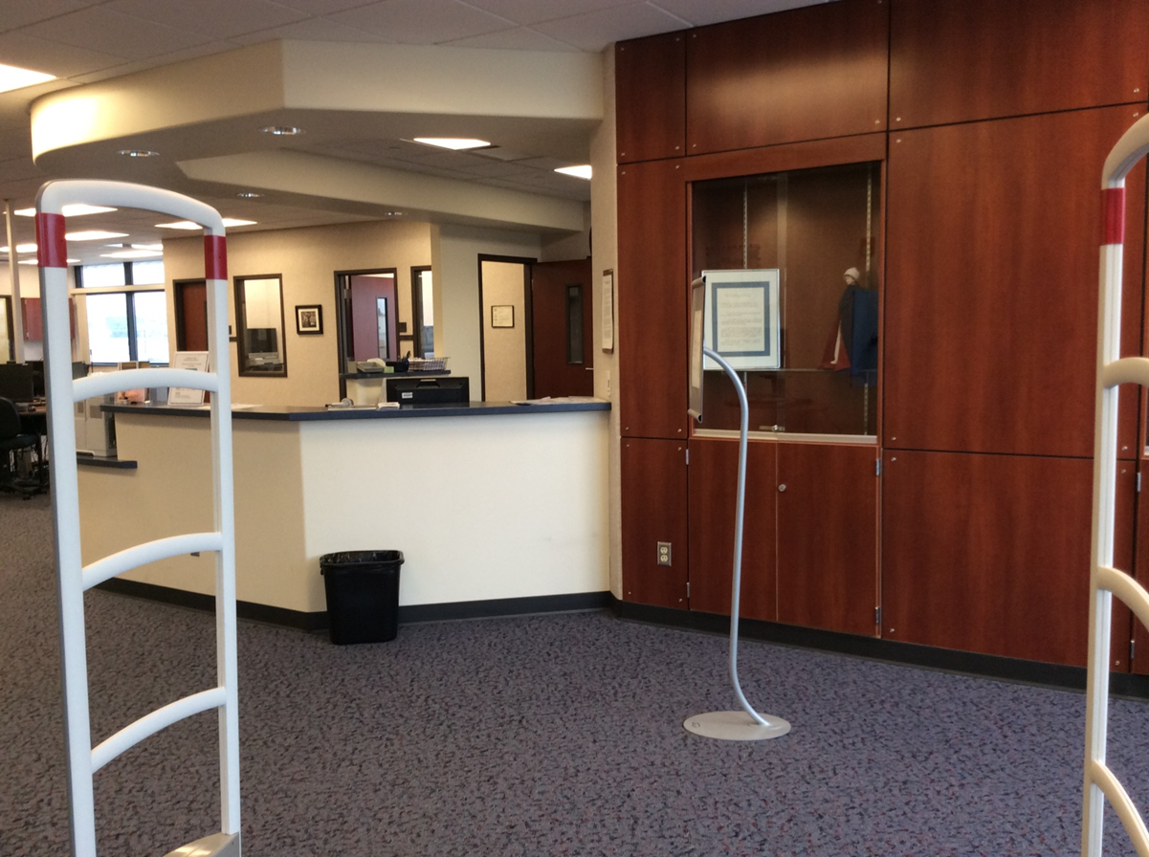
Thank You!
Hope to see you around!

