Slide 1
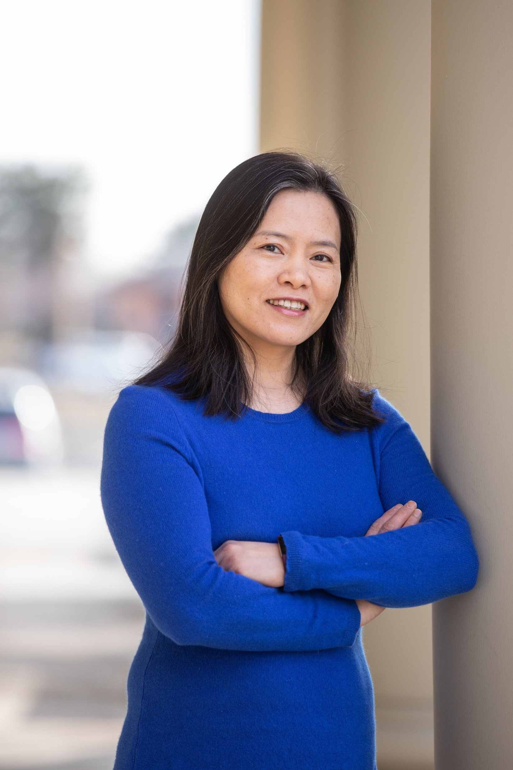
Health Sciences Library Orientation for LPN-BSN Students
Ying Yu
yyu@columbiabasin.edu
Librarian
May 2023

Slide 2
Orientation outcomes
Participants will:
Know CBC library resources and services
Learn about HEAL-WA
Meet the librarian
Be encouraged to:
reach out to librarian for individualized support

Slide 3
Health Sciences Library Hours
Monday – Thursday 7:30am – 4:00pm
Friday 7:30am – noon
Weekends, Holidays, & Breaks Closed
Notes:
Regular hours during the quarter.

Slide 4
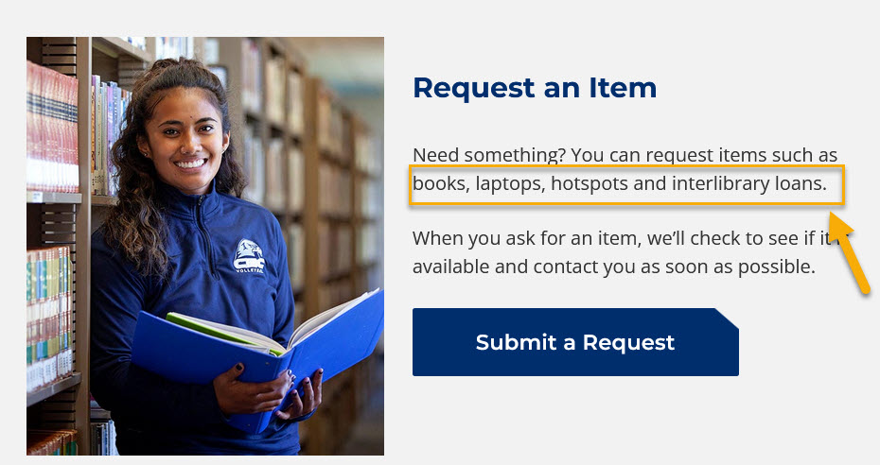
Health Sciences Library
Location: 3rd floor of HSC building (HS307) in Richland
Services: research help, tech support, ILL articles
Resources:
44 computers
b/w & color printers
study rooms
books

Slide 5
Computer Login
Login: Student Email Username
firstnitiallastname# (e.g. rsmith2)
You do NOT need to add the full email address @students.columbiabasin.edu
Password: Your Email Password

Slide 6
EXPIRED PASSWORD
Change it on a CBC computer when prompted
New password needs to be complex enough and not the same as any previously used ones; Can not include any part of your name
Write down your new password!!!
This is your new password for Canvas, Wifi, and email!

Slide 7
Try it out Login to a CBC Computer

Slide 8
CONNECT TO WIFI
Do NOT choose the guest Wifi (slower; does not work for Canvas; can’t connect to NetPrint)
Choose “CBC-WIFI”
Username: CBC student email username only
Password: student email password
See detailed Instructions

Slide 9
Office 365 and Onedrive
Login to your email through the quick links on the CBC website
Click on the square icon made up with nine dots in the top left corner to access OneDrive
It’s a good place to keep your documents and use MS Word, PPT, etc.

Slide 10
NetPrint
Use your own laptop or a CBC computer
Login to NetPrint
$12 credit/quarter; 400 pages in b & w
If needed, buy $3.00 cards at front desk
Notes:
$12 equals to about 400 pages black and white at 3 cents per page/side, default double-sided. Color is 9 cents per page, default single-sided.

Slide 11
HSC Printers
G1111 (library Main Area)
G1124 (library computer Lab)
G1157 (Color) (library front door)
G1174 (HSC 1st floor lounge,
available whenever the building is open)

Slide 12
Printing
Only NetPrint Web Print is available now on the Richland campus
You can NOT click on ‘file”, “print”, and directly choose a printer
You have to login to NetPrint and then upload a file to print

Slide 13
Links to NetPrint
https://www.Columbiabasin.edu/netprint
Click on “NetPrint Accounts”
Click on “Log in”
Bookmark the login URL for quick access later http://netprint.columbiabasin.edu:9191/app
(This link only works when you are on campus and connected to “CBC-Wifi”)

Slide 14
NetPrint Login
Username: CBC student email username only
Password: student email password

Slide 15
Print PPTs with NetPrint
Click File-Print and choose the printer option “Microsoft Print to PDF”.
Select “3 Slides” or “6 Slides” per page
Save the PPT file as PDF in a location (e.g. Documents, or Downloads) for uploading later.
Or Save a PowerPoint as an XPS file

Slide 16
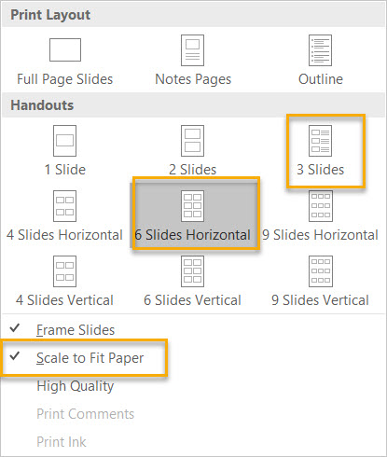

Slide 17
NetPrint- Web Print
Step by step instructions for Web Print
Once in the NetPrint system, click on “Web Print” on the left side menu and then follow the directions to upload the file to the system to print. Click on the green buttons in each step.
After the file has been sent to the print server, you will see “Rendering print job” message as it works.
Click “Held in a queue”
Click “Print”

Slide 18
NetPrint – More Notes
Black & white printers print double -sided
Files more than 50 pages may not upload
Test one file first and pick up promptly
Notify library staff or IT help desk if out of paper/Jam

Slide 19
How to Sign out
Click on the Windows icon:
Click on your photo or the person icon
Choose “Sign out”

Slide 20
Try it out
Connect a personal device to CBC-WIFI
Use the search function of windows to find “Firefox” or “Chrome” to open a browser
Login to your NetPrint account
Login to student email and find OneDrive
Know how to “Sign out” of the computer

Slide 21
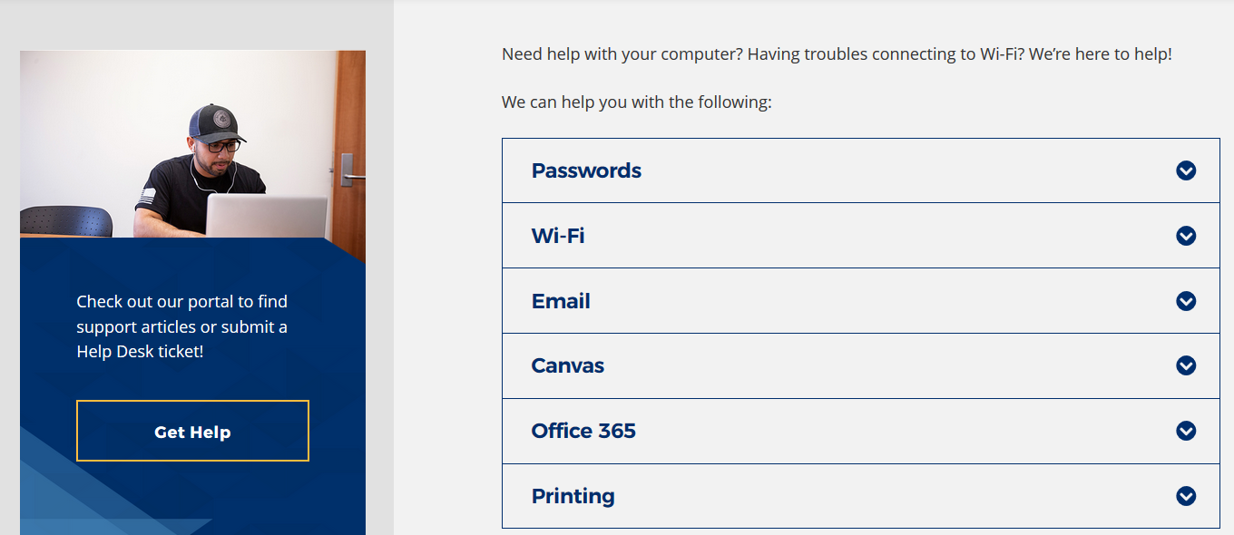
509-543-1445 Student Help Desk
Student Help Desk – Remote Tech Support
509-543-1445
shelp@columbiabasin.edu
Notes:
If you come to the Richland Health Sciences Center in person, library staff can help you with Wi-Fi, printing, and Office 365 too.

Slide 22
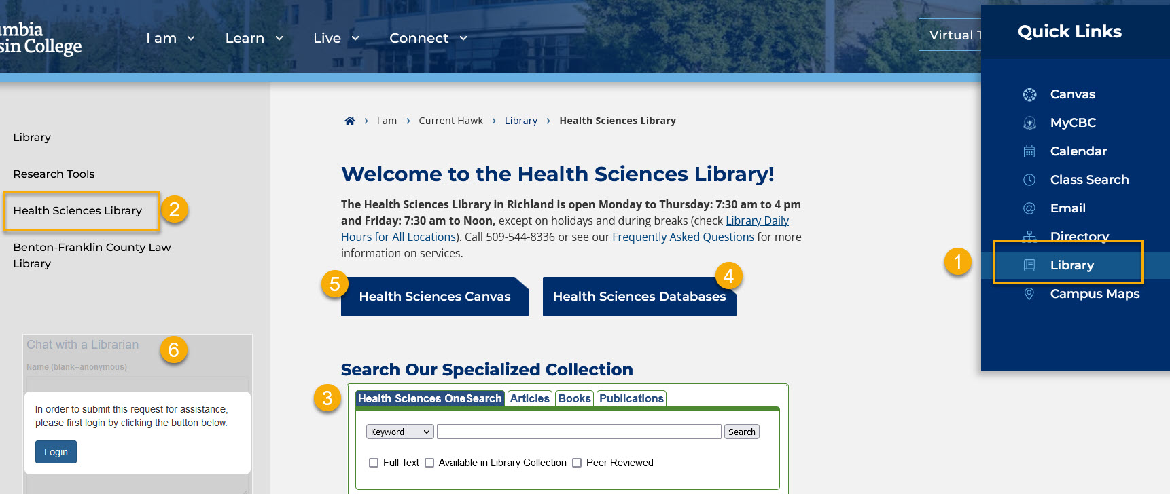
Health Sciences Library Homepage
columbiabasin.edu/hslibrary
1. Quick Link to the main library page
2. Link to Health Sciences Library
3. Health Sciences OneSearch
4. Individual databases list
5. Health Sciences Canvas open course
6. Chat with a Librarian
Notes:
The quickest way to go to the library’s homepage is by using the Quick Links on the CBC homepage. The Health Sciences OneSearch search box has a green outline. It searches multiple databases in the Health Sciences and Medicine categories at the same time.

Slide 23
Library Databases
(Login from home with student email & password)
OneSearch or Health Sciences OneSearch
CINAHL with Full Text
Gale Health & Wellness
Nursing Reference Center Plus
MicroMedex
View full list

Slide 24
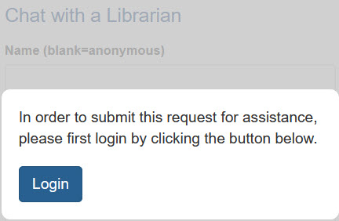
Chat with a librarian
Access from the library homepage (columbiabasin.edu/library)
Chat monitored by CBC librarians with instant Zoom capability during the quarter
Mon. to Thu.: 8 am to 4 pm
Friday: 8 am to noon
Chat is also available 24/7
backup non-CBC librarians
Notes:
I encourage you to use the “Chat with a Librarian” service. A human (librarian) actually will answer you, even in the middle of the night because this is a collaborative service that we joined with other librarians throughout the world. Sometimes you might be getting help from a librarian in Bellevue College. You might get help on how to find a reputable website from a librarian in Hong Kong. You might get help on how to use a better keyword to do your search from a librarian from the United Kingdom. If they can't answer a question that's pretty local, a CBC librarian will follow up by email.

Slide 25
Quick search demo
Health Sciences OneSearch
Put different keywords/concept words in search boxes
Use OR to connect synonyms
Use the limiters:
Dates
Source types
Results:
Permalinks
Cite tool

Slide 26
Pair up & Try it out
Find the CBC Library main homepage
Find the Health Sciences Library homepage
Find the list of Health Sciences databases
Locate the “Chat with a Librarian” box
Try a simple search (Find one article on a topic of your interest and copy and paste the permalink and APA citation in a new document on your OneDrive)
Questions?

Slide 27
HealWA
A health information resource portal – Free to licensed healthcare professionals including LPNs and RNs in Washington.
How to set up access (3-min video)
Databases:
CINAHL Complete
MEDLINE Complete
DynaMed
Joanna Briggs Library
View Nursing Toolkit for more databases
E-books
Continuing Education
Document delivery service

Slide 28
HealWA Ejournals
Journal of Nursing Administration
MCN
Nursing Care Quarterly
Nursing Management
Nurse Practitioner
Nursing Research
(On the Databases page, click on EJOURNALS to search for more)

Slide 29
Quick demo
Search DynaMed
How to find out if full text of a specific journal is available

Slide 30
Pair up & Try it out
Find the HEALWA homepage
Do the first step for setting up access
Browse the databases in the toolkit for LPNs and RNs
Search for the full text of a journal (e.g. Nursing Research)
Find the CE education page
Try DynaMed (Only if successfully logged in)
Questions?

Slide 31
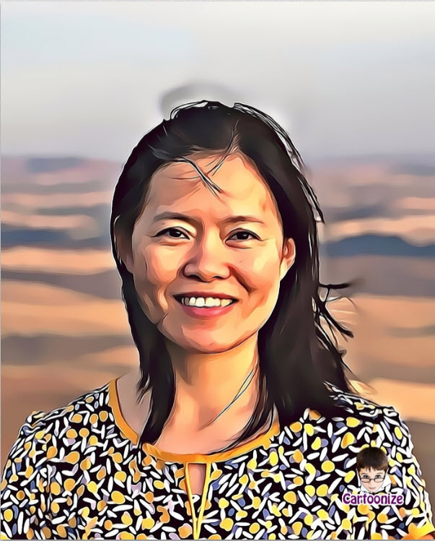
Librarians Can Help
Show you how to search CBC and/or HEALWA databases effectively;
Help you search for references, books, articles, statistics, and reputable websites;
Get full text of articles that are not already available as a free service to students (Request form);
Provide APA style help (https://bit.ly/CBCAPA)
Ying Yu, Health Sciences librarian
Please email me: yyu@columbiabasin.edu, or
Submit a Question/Request an Online Meeting
(I’d love to meet with you for a research consultation through Zoom or in person!)

Slide 32
Library Session Feedback
Your feedback is greatly appreciated for improvement for future students!
Thank you!
The link can be found in the Health Sciences Canvas page (Scroll down to the bottom under the module for LPN-BSN).

Slide 33
Remember to Log Off
Click on the Windows icon:
Click on your photo
Choose “Sign out”

