Slide 1
Introduction to Library Research for Chemistry 292
Example Topic: Nanoparticles To Deliver Plant Nutrients

Slide 2
Topics
Database selection
EBSCO Discovery Service
ProQuest
Google Scholar
Search structure
Narrowing/Broadening
Evaluating sources
Cite/Print/Save/Interlibrary Loan

Slide 4
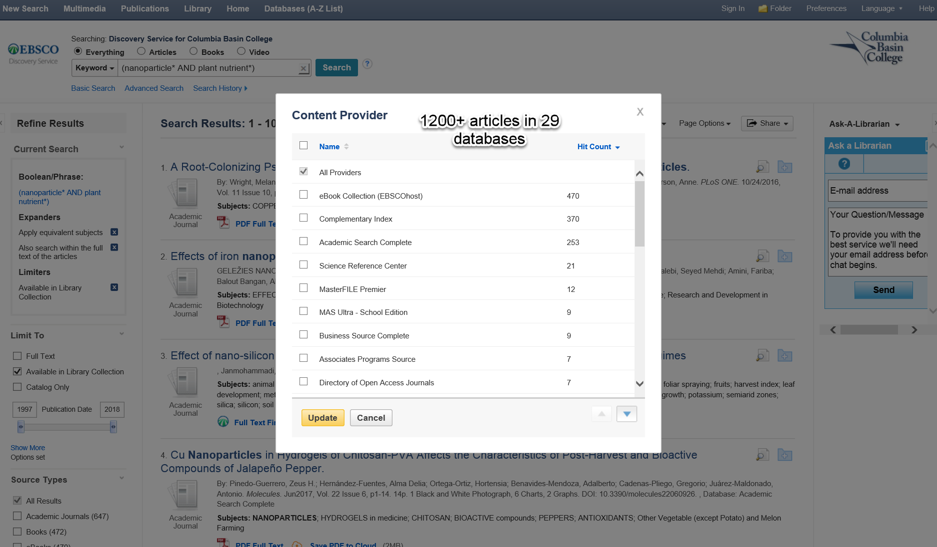
https://goo.gl/f8jhFe

Slide 5
Indexing in EDS, Full-text in ProQuest
Current Microbiology
Plant Growth Regulation
Nanotechnology Reviews
Trends in Biotechnology

Slide 6
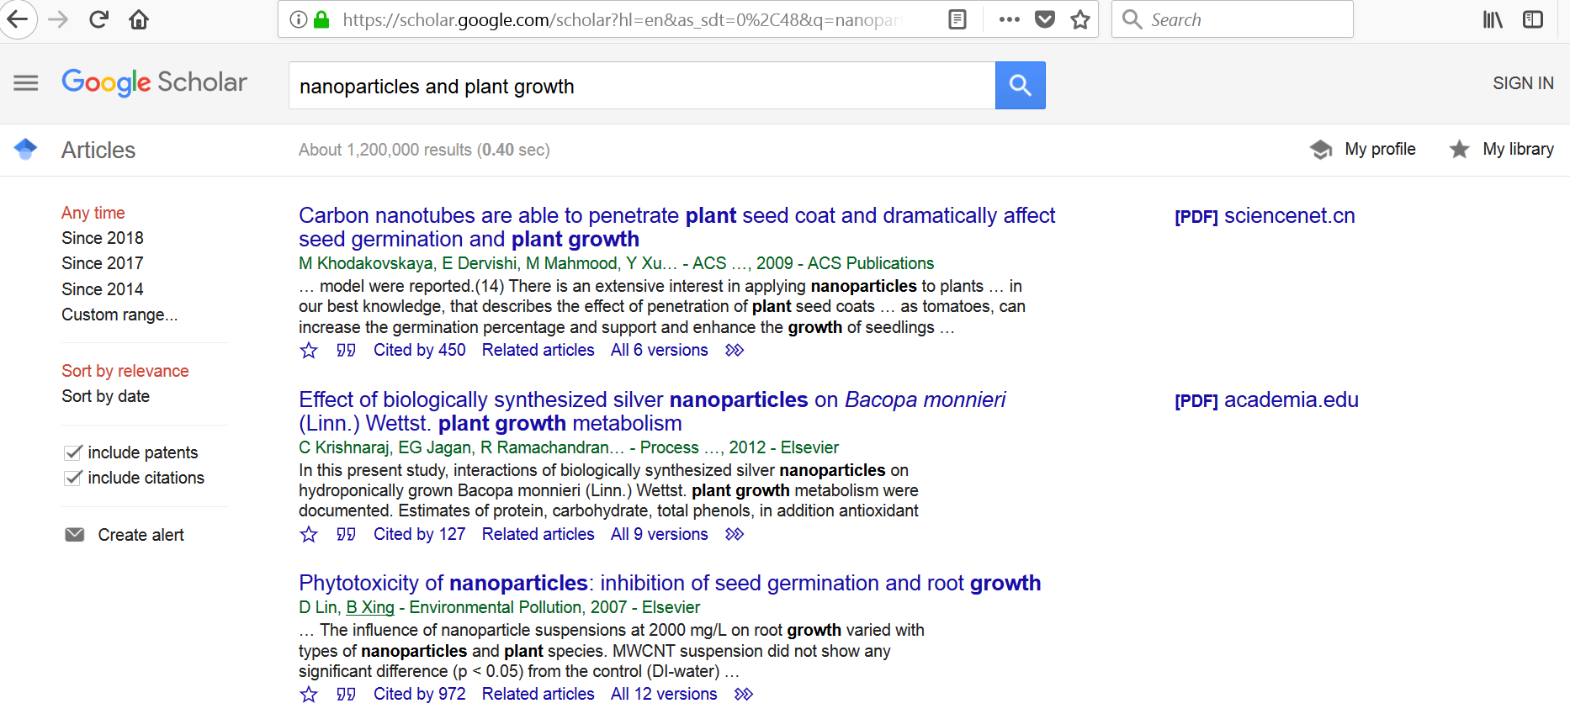
scholar.google.com

Slide 7
Search Techniques
Keywords – How can nanoparticle technology supply plant nutrients?
Truncation - takes the place of one or more other characters at the end of a word
nutri* = nutrition, nutrients
And – used between keywords to narrow
nanoparticle* AND plant* AND nutri*
Or – used between keywords to broaden
nanoparticle* OR nanotech*
Phrase – these characters in this order
“plant nutrition” (ProQuest!)
Notes:
If I already have an idea for a topic I can use the following search techniques to explore it. Choose search terms that are unique but commonly used in the scholarly literature (that is, no slang). Some can be made to work harder for you by chopping off the end of the word and replacing it with a star (shift-8) character to capture the plural and other variant forms. This is at least a three concept search so narrow it by placing each concept on its own search line connected with AND between the lines. When you have multiple words that represent a concept you can broaden your search by including each one typing OR between them on a single line. Use phrases with care, they really narrow your search; best to use when it is a sure thing (United States) or you’ve already seen them as a subject heading.

Slide 8
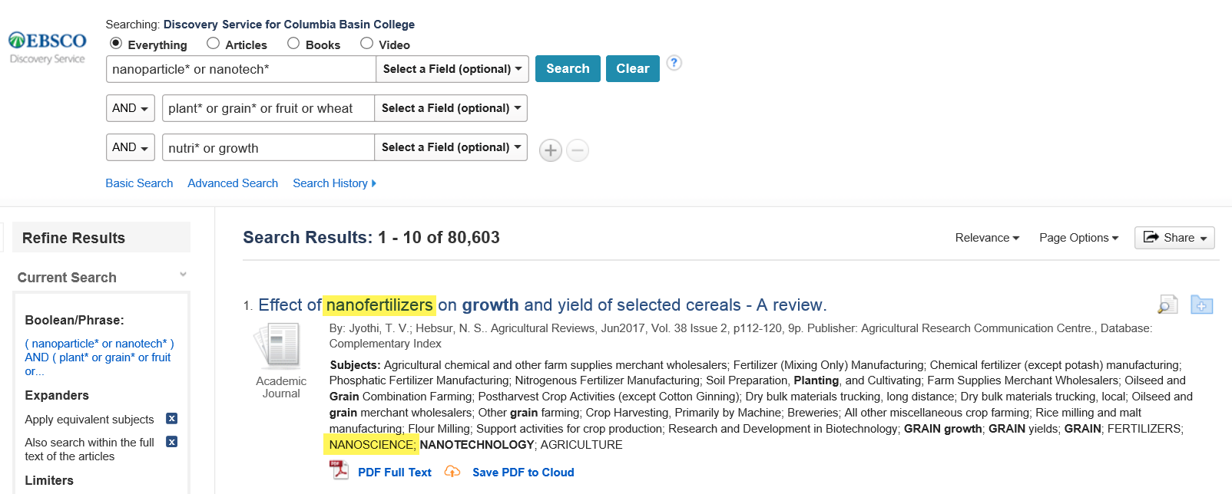
Example Searches - Broadening
Nanoparticles in plant nutrition – 29 results
nanoparticle* AND plant nutrition - 697 results

Slide 9
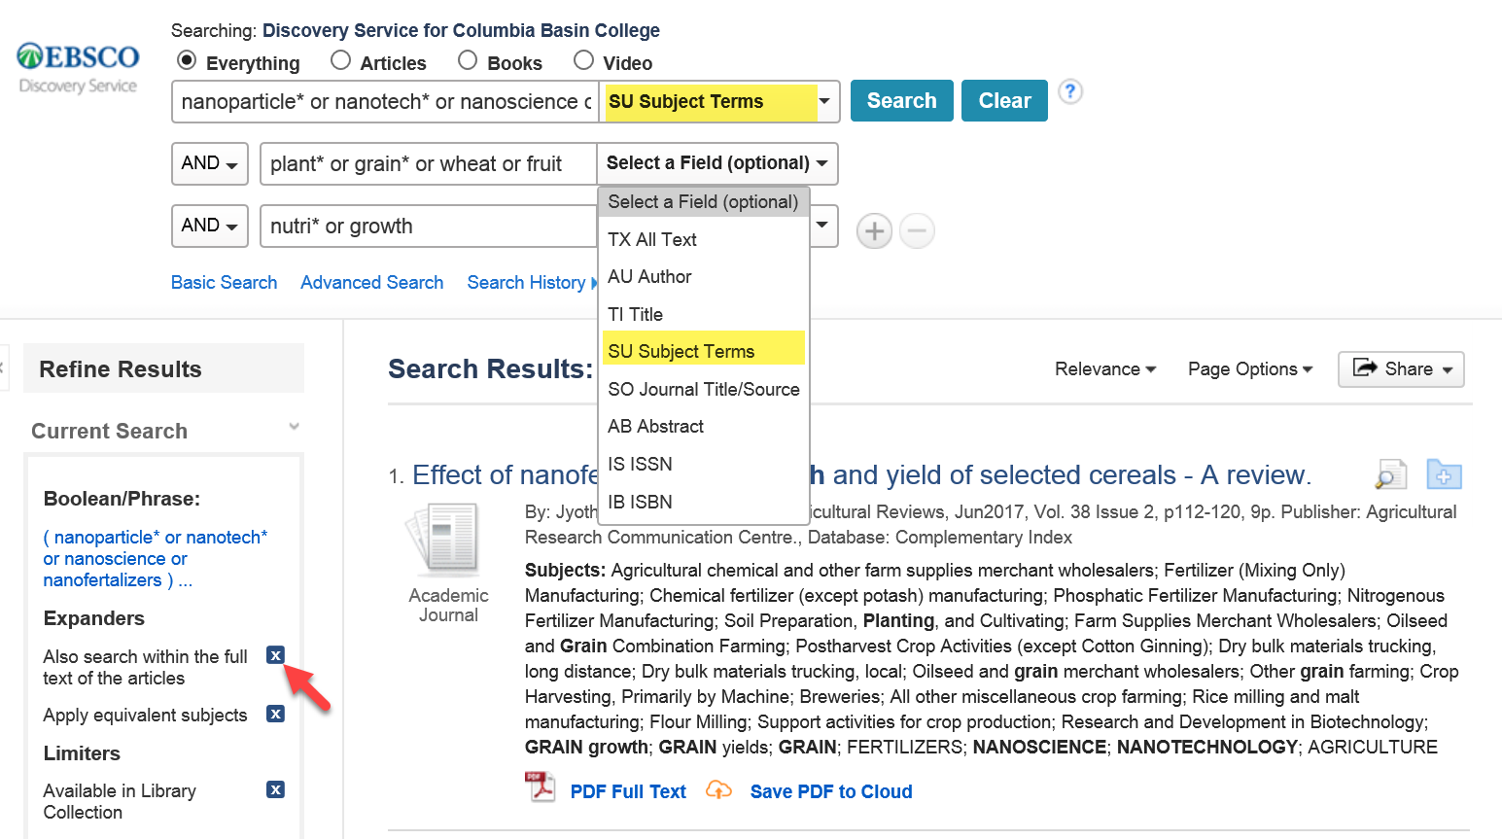
Narrowing

Slide 10
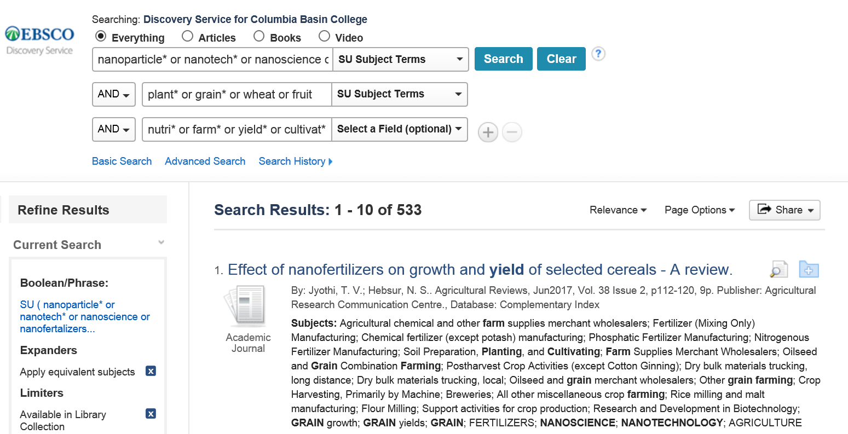
Example Search - Narrowing
( nanoparticle* or nanotech* or nanoscience or nanofertalizers ) AND ( plant* or grain* or wheat or fruit ) AND ( nutri* or growth ) – 82,086 results
https://goo.gl/JitnBF

Slide 11
Evaluating Sources
SU ( nanoparticle* or nanotech* or nanoscience or nanofertalizers ) AND SU ( plant* or grain* or wheat or fruit ) AND ( nutri* or farm* or yield* or cultivat* or culture or fertiliz* ) - 538 results
416 Academic journal articles (51 magazine, 14 trade pubs)
Experimental (ex. “Effects of TiO2 nanoparticles on wheat (Triticum aestivum L.) seedlings cultivated under super-elevated and normal CO2 conditions”
Review (ex. “Effect of nanofertilizers on growth and yield of selected cereals - A review”
2000-2018, organized by relevance
486 in English

Slide 12
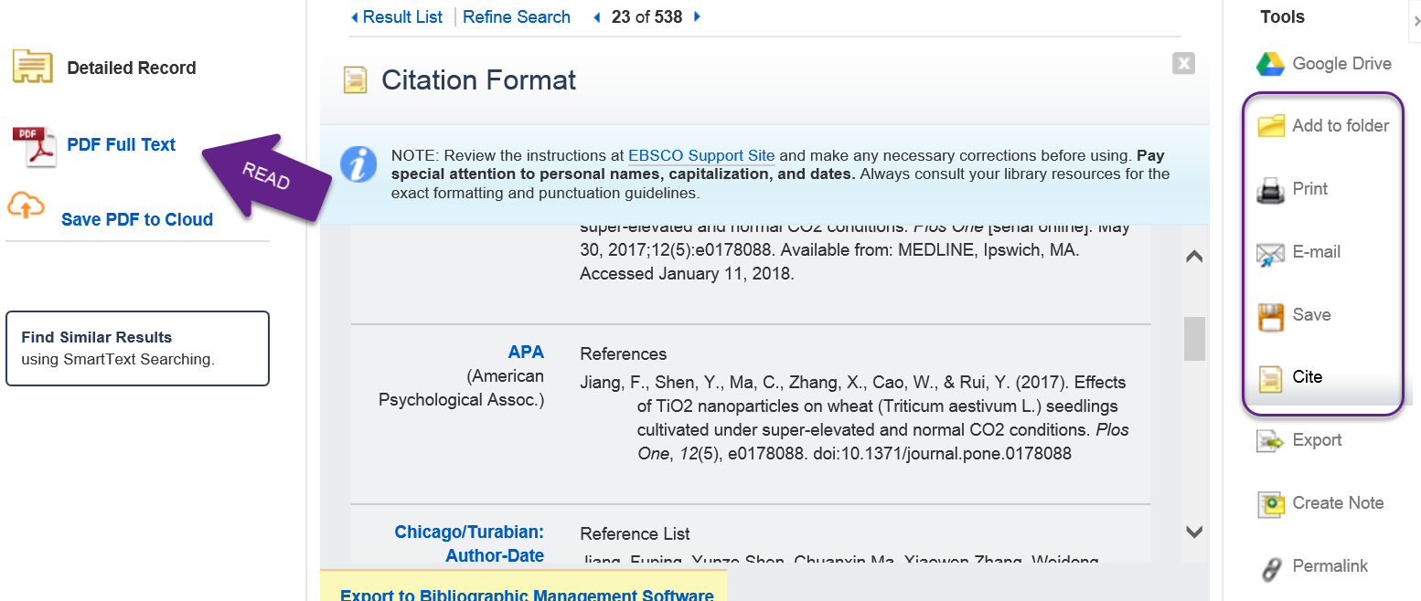
Read/Save/Cite

Slide 13
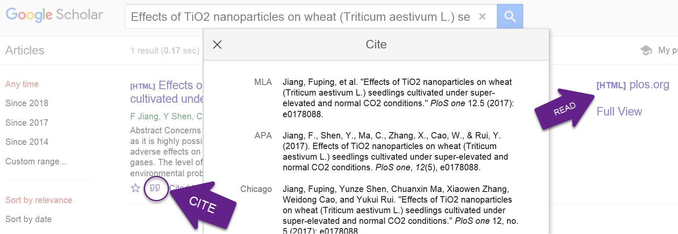
Read/Save/Cite

Slide 14
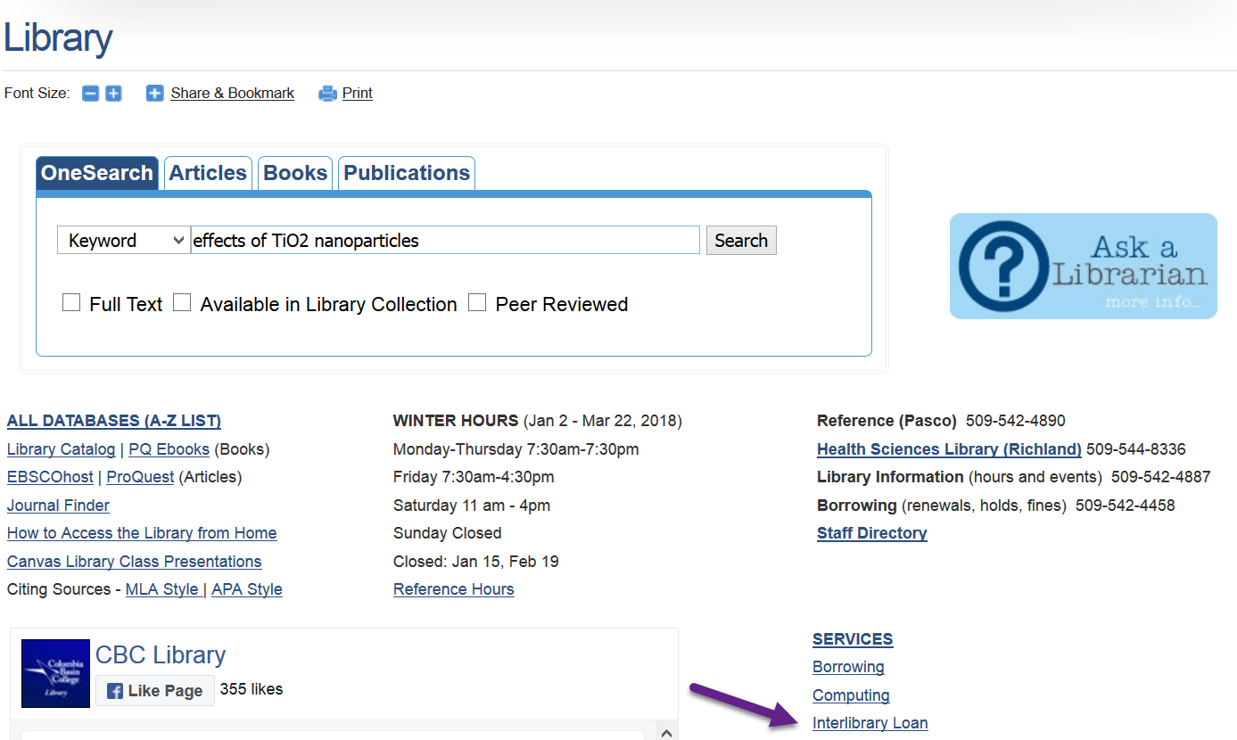
Interlibrary Loan

