Slide 1
Searching for books
Example Topic: Free College Tuition
Notes:
NOTE:
To change the image on this slide, select the picture and delete it. Then click the Pictures icon in the placeholder to insert your own image.

Slide 2
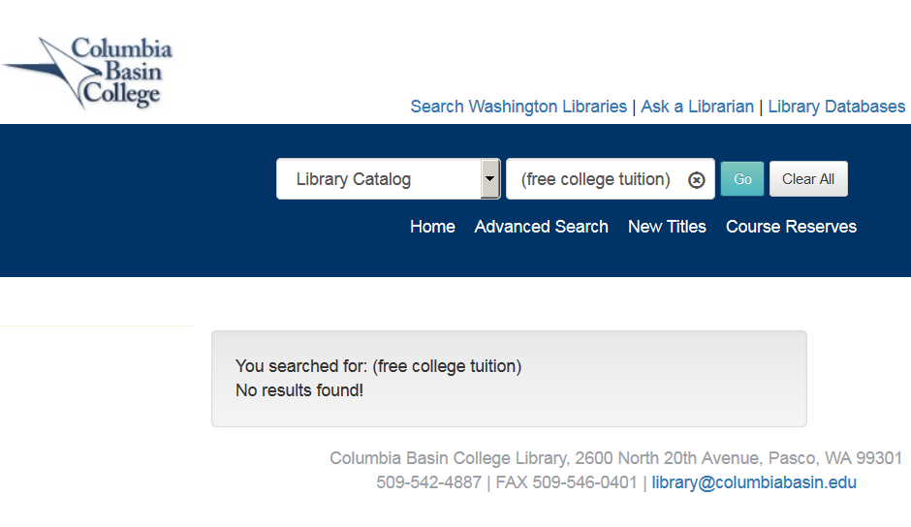
CBC Library Catalog
30,000+ Print Books
Searches title, author, subjects
Two or more words together are treated as a Boolean AND search, as: free AND college AND tuition
No results found!

Slide 3
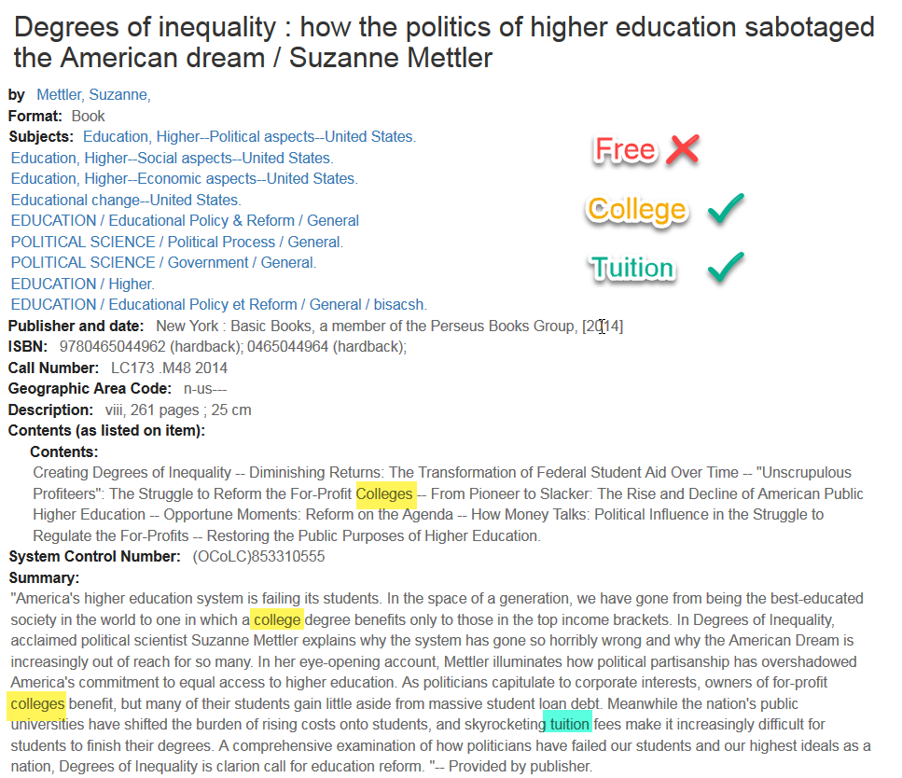
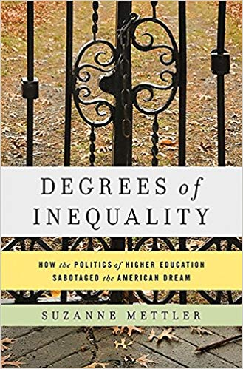
Catalog Record
357 words searched
Notes:
I wanted it to find this book, but my keywords failed me.

Slide 4
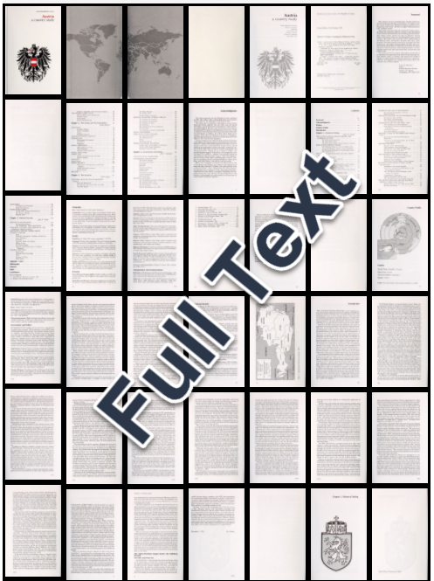
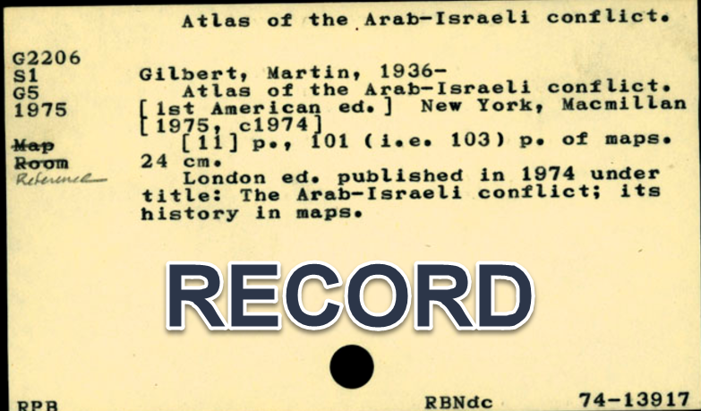
Searching in Books
EBSCOhost ebooks – 200,000+ titles
JSTOR ebooks – 70,000+ titles
ACLS Humanities E-Book – 5,400 titles
Notes:
A library catalog record can be really short, it would be better if I could search the whole book – and I can!

Slide 5
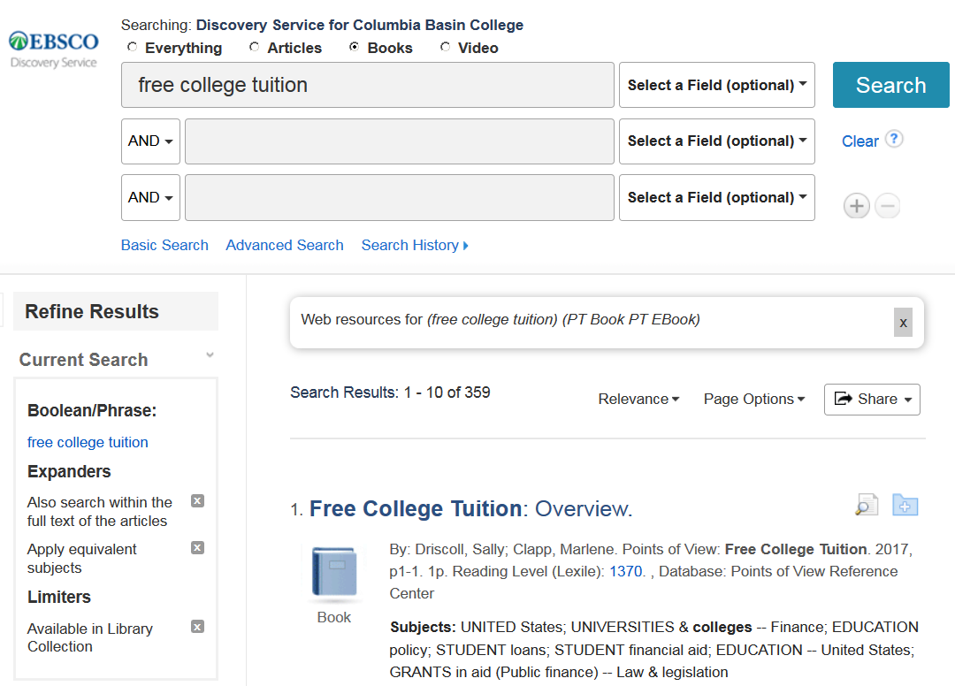
EBSCO Discovery Service
1 million+ items identified as books
Searches title, author, subjects and text
Two or more words together are treated as a phrase, as: “free college tuition”
Notes:
The EBSCO Discovery Service or ’OneSearch’ on our homepage searches most of our book content together, but unfortunately it identifies hundreds of thousands of individual reference articles as ‘books.’ Still, it is a lot easier to work with some results than no results!

Slide 6
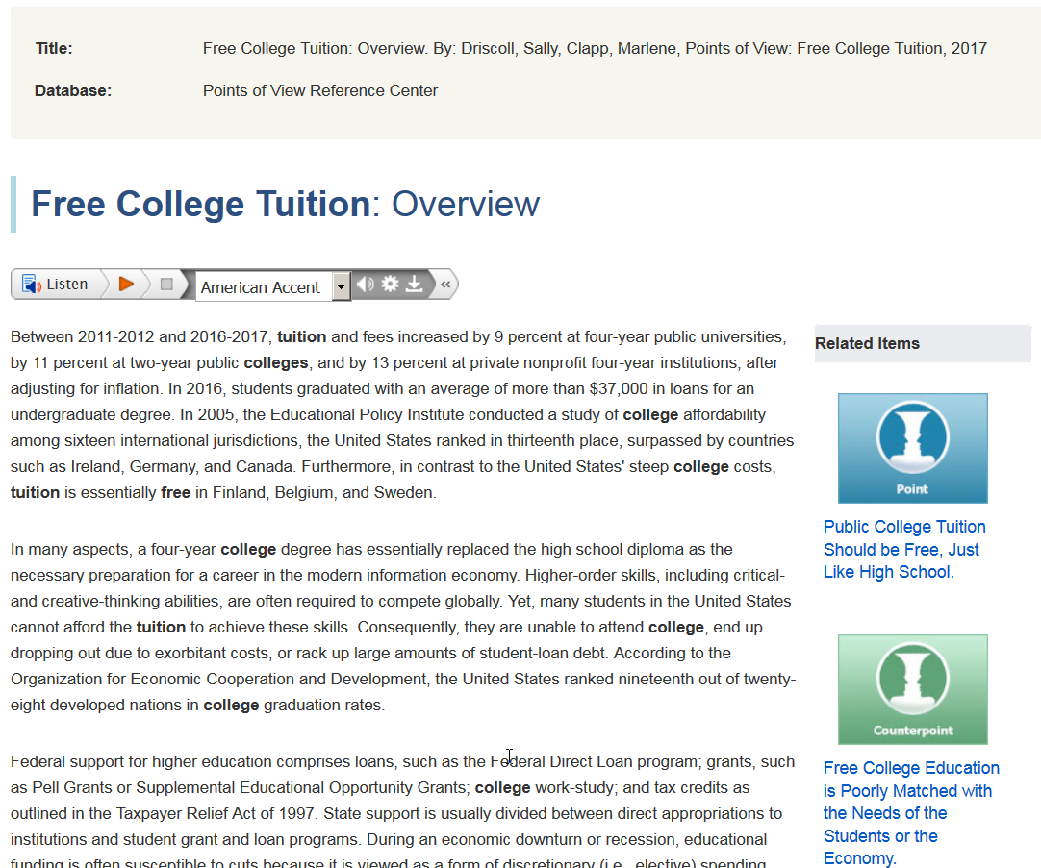
Not a book
Narrow by subject (education, college costs, student loans, etc.)
Read this anyway for keywords, persons, places, dates, bibliography
Notes:
This Points-of-View reference article is a few pages long, no idea why they have it tagged as a book, but I can still read it for the keywords.

Slide 7
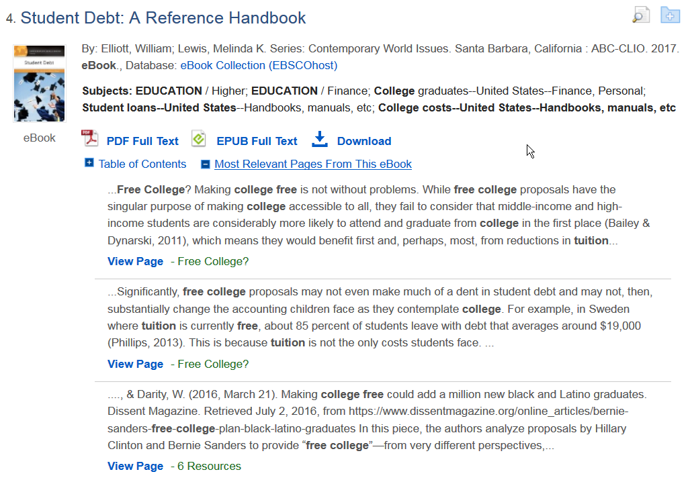
Book!
Jump to most relevant chapter
Read online or print/email/save up to 100 pages
Note subjects
Notes:
Here is an actual book – it has book in the title and everything! I can click on ‘most relevant pages’ and see immediately why this is in my list, if I had any doubts.

Slide 8
A better search
College* | Tuition | United States
Universit* | loans | America
Education, Higher | finance | Washington State
 | costs
Search Statements
AND – Narrows: College* AND Tuition
OR – Broadens: Loans OR Costs
Phrase – Very Narrow: “college costs”
Truncation – Expands: universit* = university, universities
Careful: univers*= universe, universal, universally…
Notes:
I’ve gathered keywords and phrases. I’ve grouped them into categories which will be used on two or more lines in library databases. The AND operator appears between the search lines in the database automatically, so if I put one concept per line it should limit my search down.

Slide 9
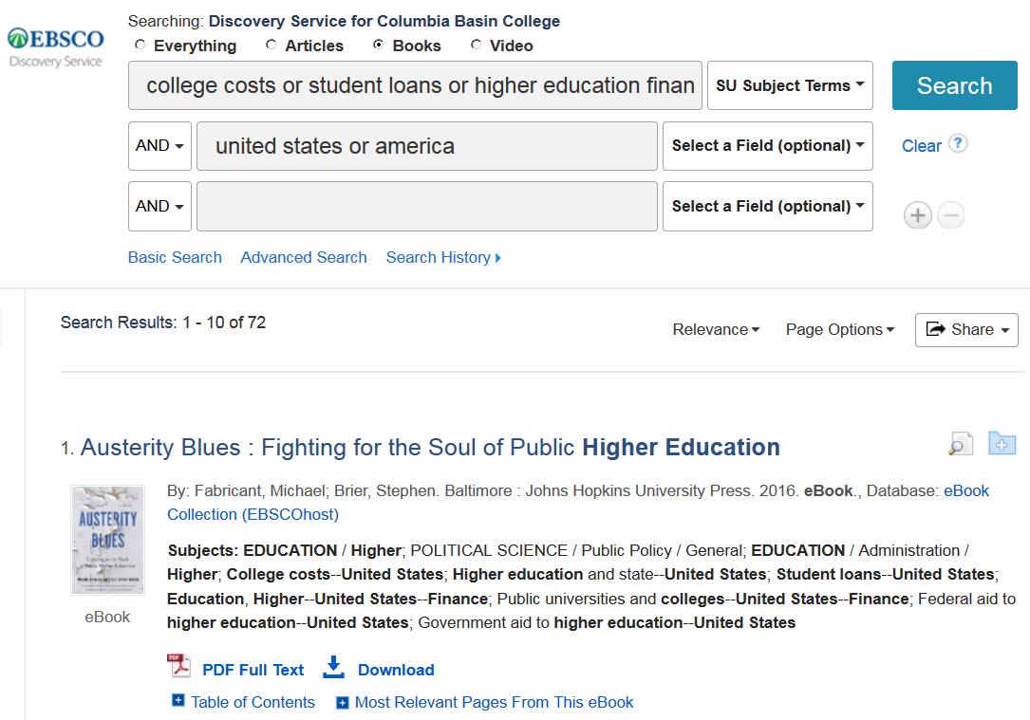
Notes:
Once I find useful books I can gather up the subjects and search them specifically, either one at a time by clicking the links or all at once by putting them on a line with or between them.

Slide 10
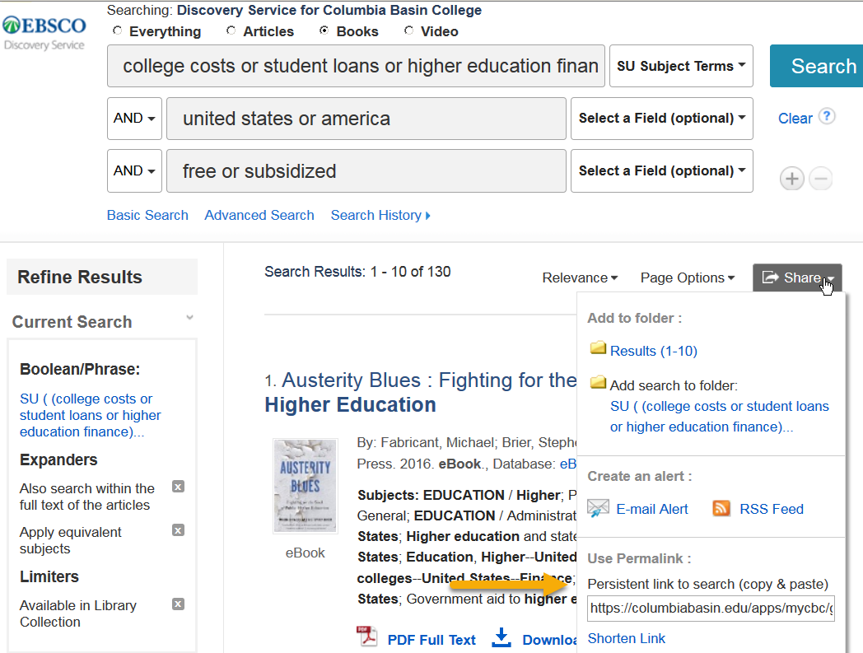
Notes:
If I’m not done with this search I can save it – use ‘shorten link’ and paste it in an email to yourself.

Slide 11
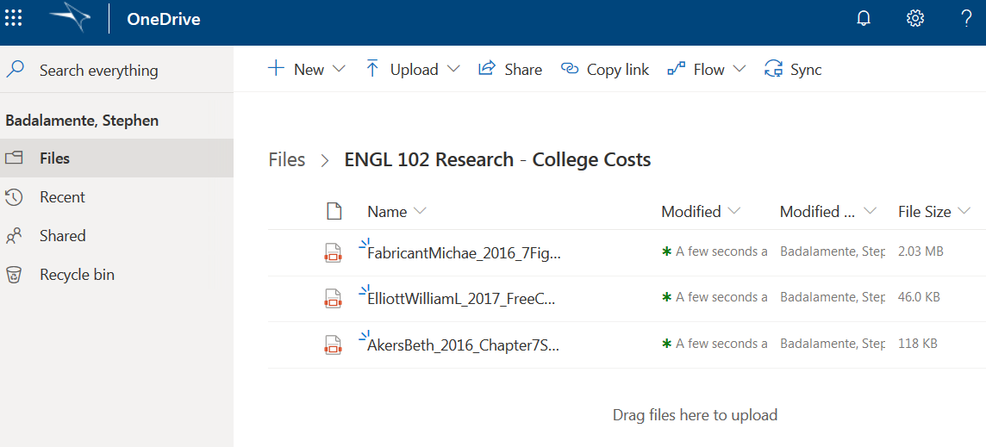
My Research
Main Collection Book, 2 Week Loan LC173 .M48 2014
Notes:
I can pull my book off the shelf and check it out with my CBC ID. I have put useful chapters in my OneDrive – they all have citation information, but it is far from ready to cut-and-paste.

Slide 12
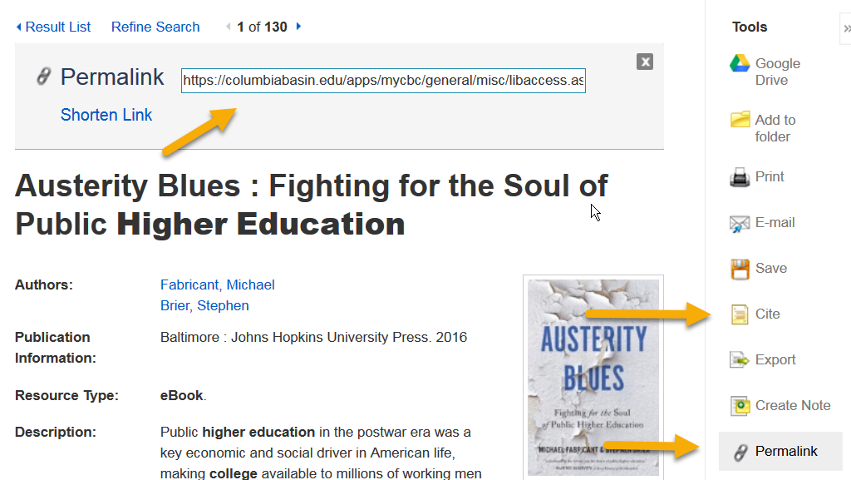
Fabricant, Michael, and Stephen Brier. Austerity Blues : Fighting for the Soul of Public Higher Education. Johns Hopkins University Press, 2016. EBSCOhost, columbiabasin.edu/apps/mycbc/general/misc/libaccess.aspx? url=http%3a%2f%2fsearch.ebscohost.com%2flogin.aspx%3fdirect%3dtrue%26db%3dnlebk%26AN%3d1220069%26site%3deds-live%26scope%3dsite
Notes:
Maybe your instructor will let you use the shorten link…?

