Slide 1
Online Student Course Evaluations Info Session
-with Monica Hansen and Terry Rueckert

Slide 2
Course evaluations and YOU
“Welcome to CBC’s new web-based student course evaluation system. It’s the same old student course evaluation with some new twists. First, you as faculty can decide whether or not you want to participate.
Instead of paper and pencil form, or Google docs version, the official CBC student course evaluation can be accessed by students through Canvas. This online form enables students to complete the multiple choice items and submit open-ended responses and comments just like the paper form, but the comments are compiled automatically and included in a report accessed directly by you without a third-party transcribing them. You can watch the response rates for all your courses while the survey is active. You can also customize your survey by adding up to five questions of your own design to get more specific feedback on your own courses.
The Winter course evaluations will be open for students at 3/6/2017.
Please communicate with your students prior to the start date of the survey if you have any special instructions. Also, if you want to customize your survey, please do so before the start date.”

Slide 3
Course evaluations and YOU
Faculty can decide whether or not they want to participate.
Students now take the survey through Canvas—instead of in class with pen and paper
The completed report can be immediately accessed directly by you without a third-party transcribing them.
You can watch the response rates for all your courses in real time while the survey is active.
You can customize your survey by adding up to five questions of your own design before it is published

Slide 4
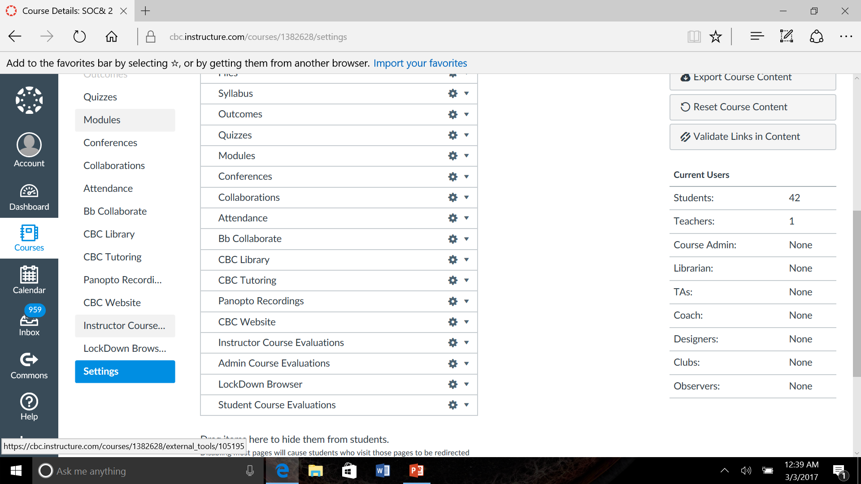
Where to find the Course Evaluation? In Canvas, in your Navigation’s page list

Slide 5
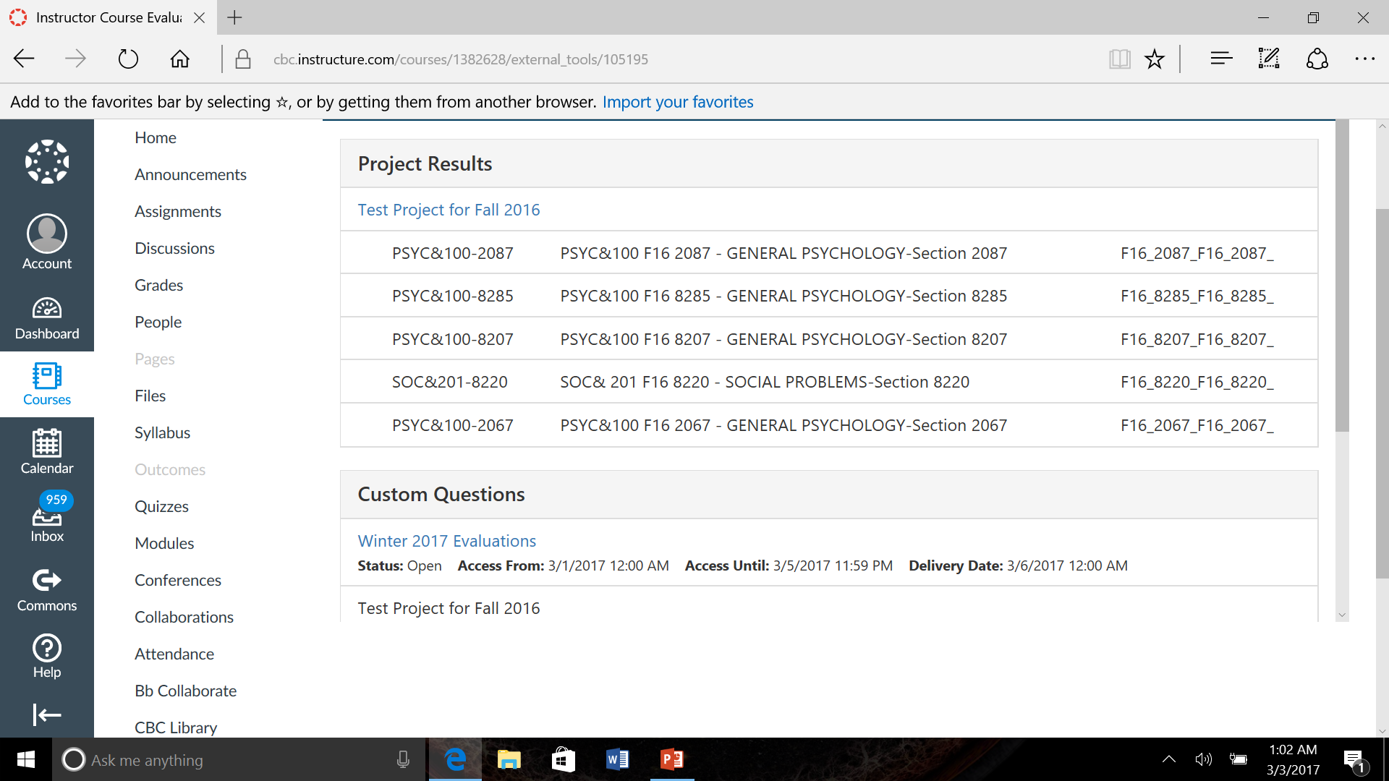
Select the Course Evaluation you have Access to, corresponding to the current quarter

Slide 6
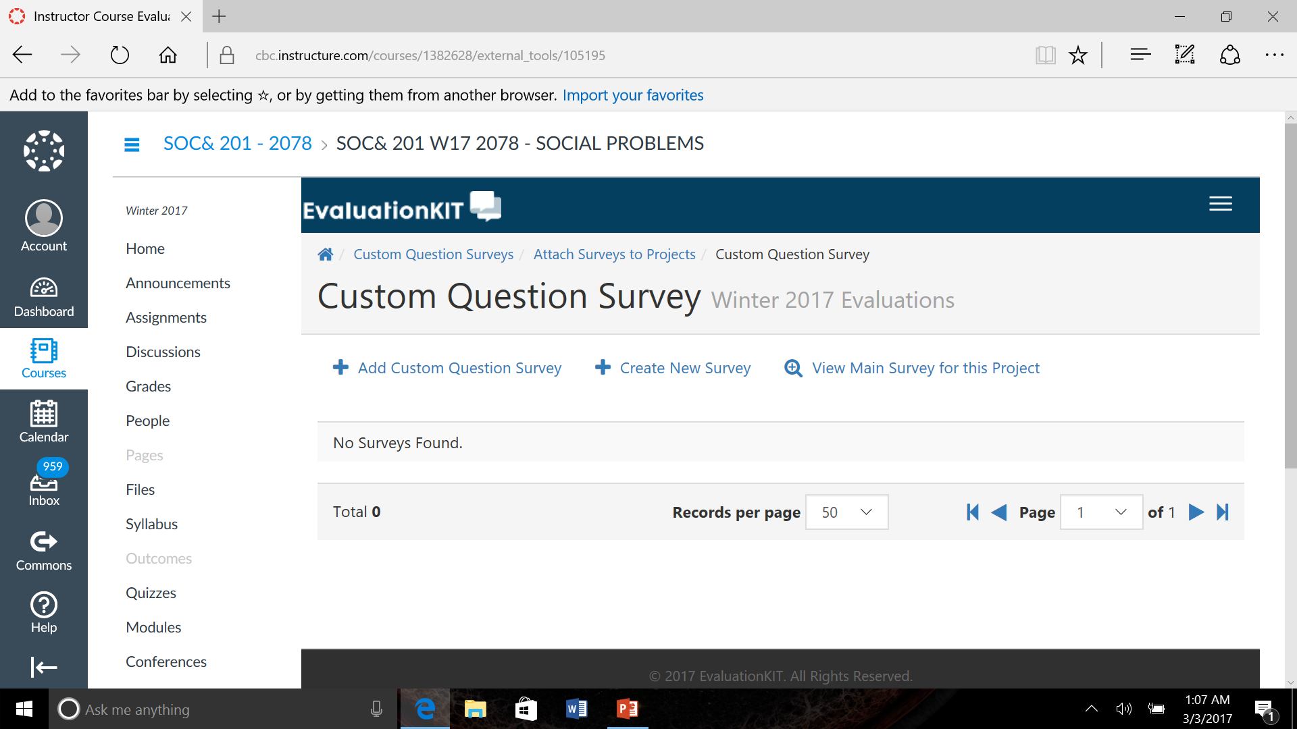
You can view the main Course Evaluations here

Slide 7
To add your own customized questions to the Course Evaluation, click “Create New Survey”

Slide 8
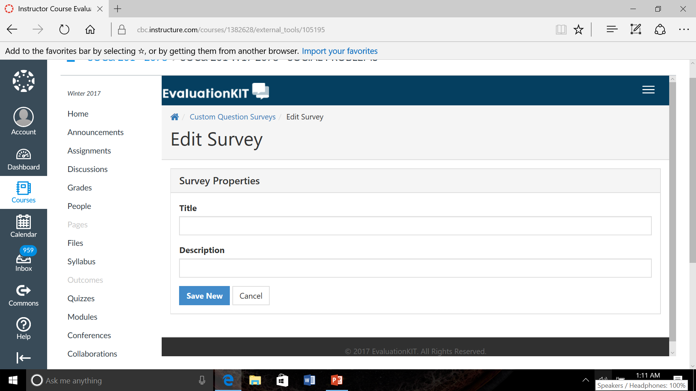
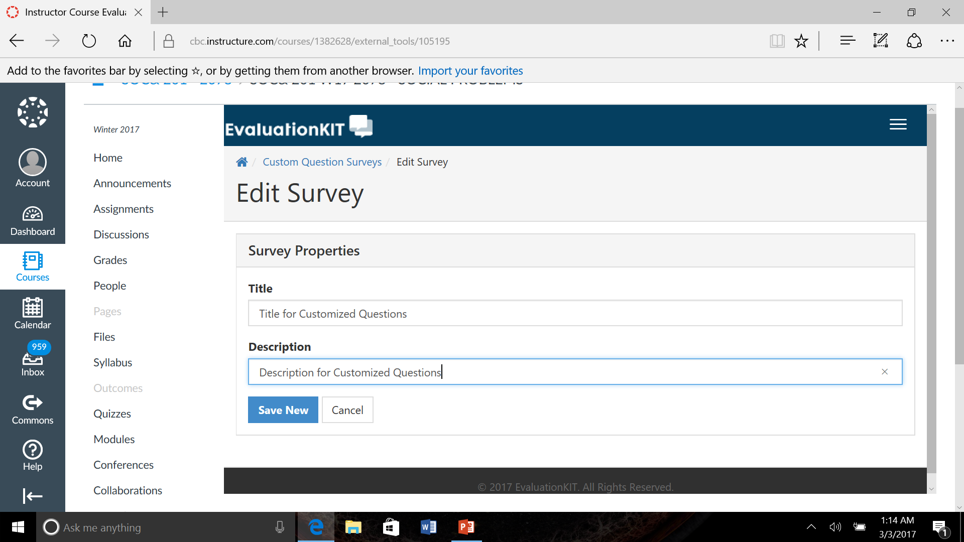
Create a title for your Custom Questions, and a description if you prefer

Slide 9
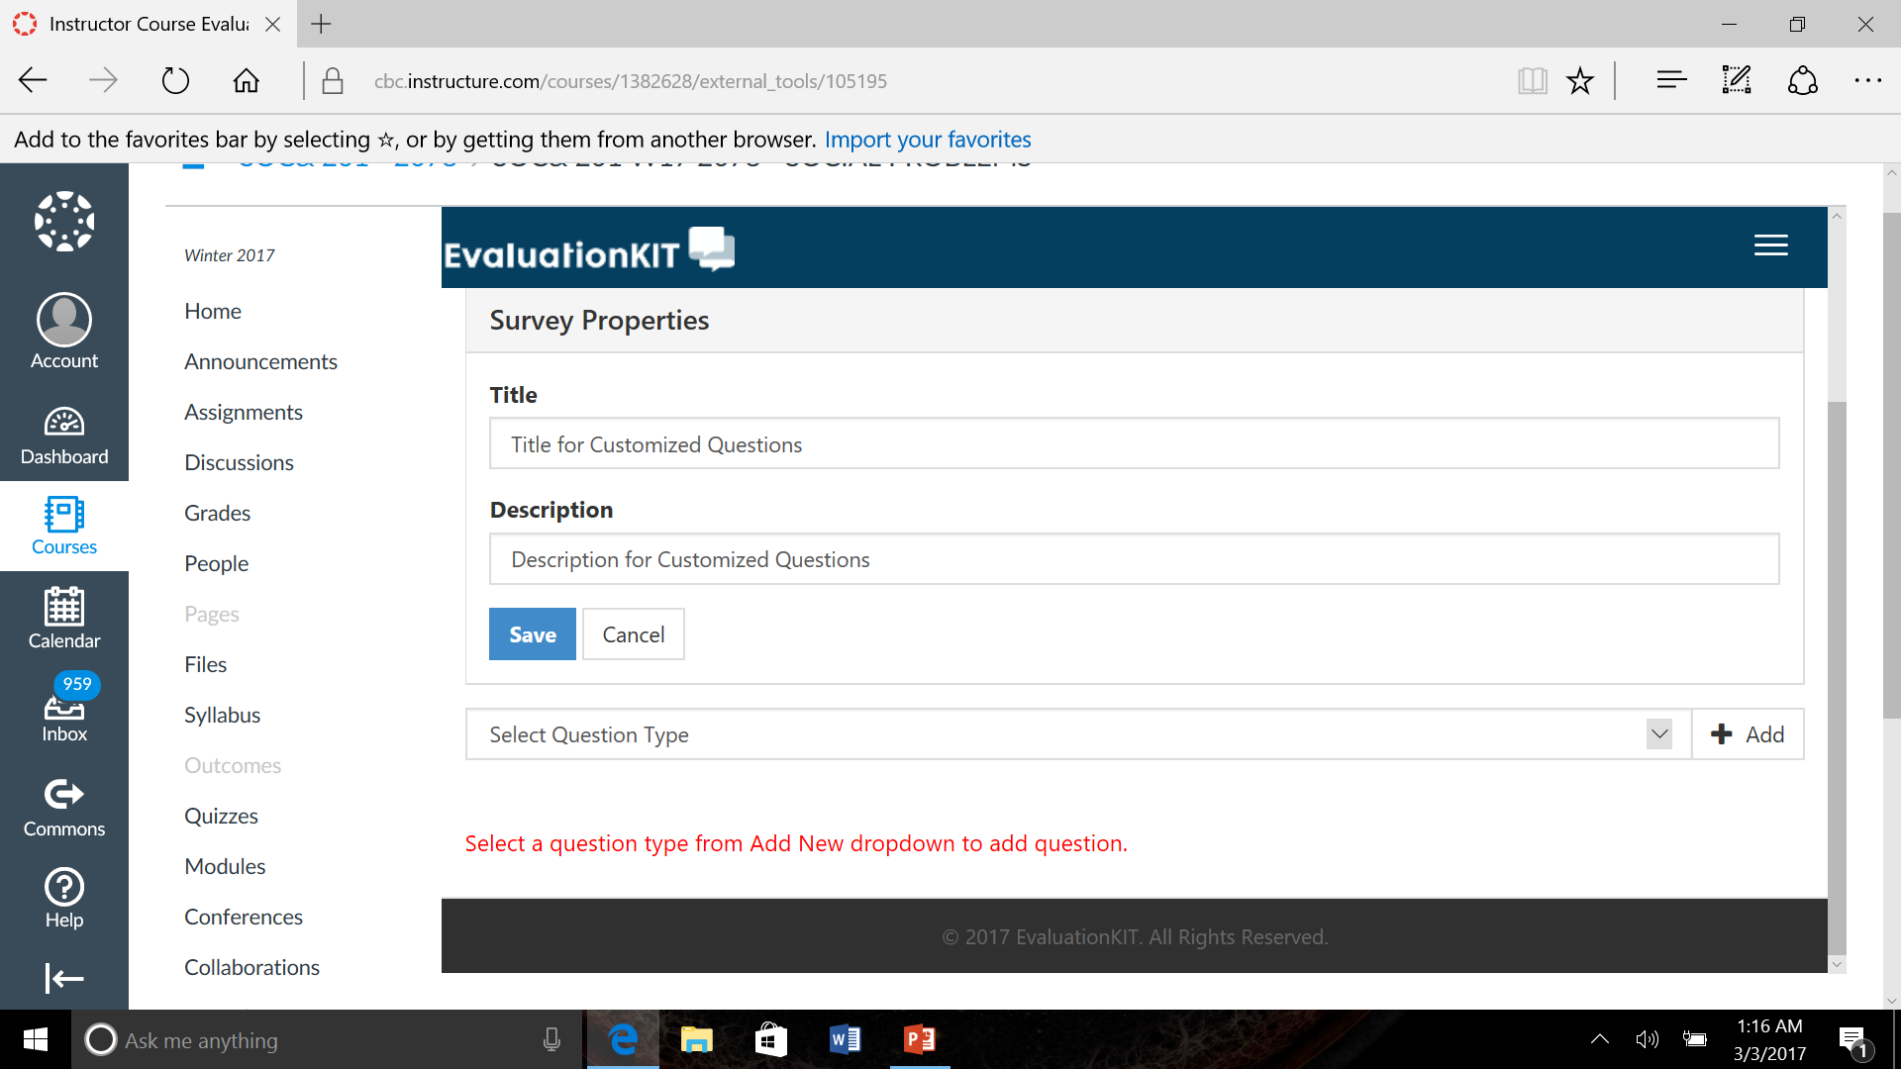
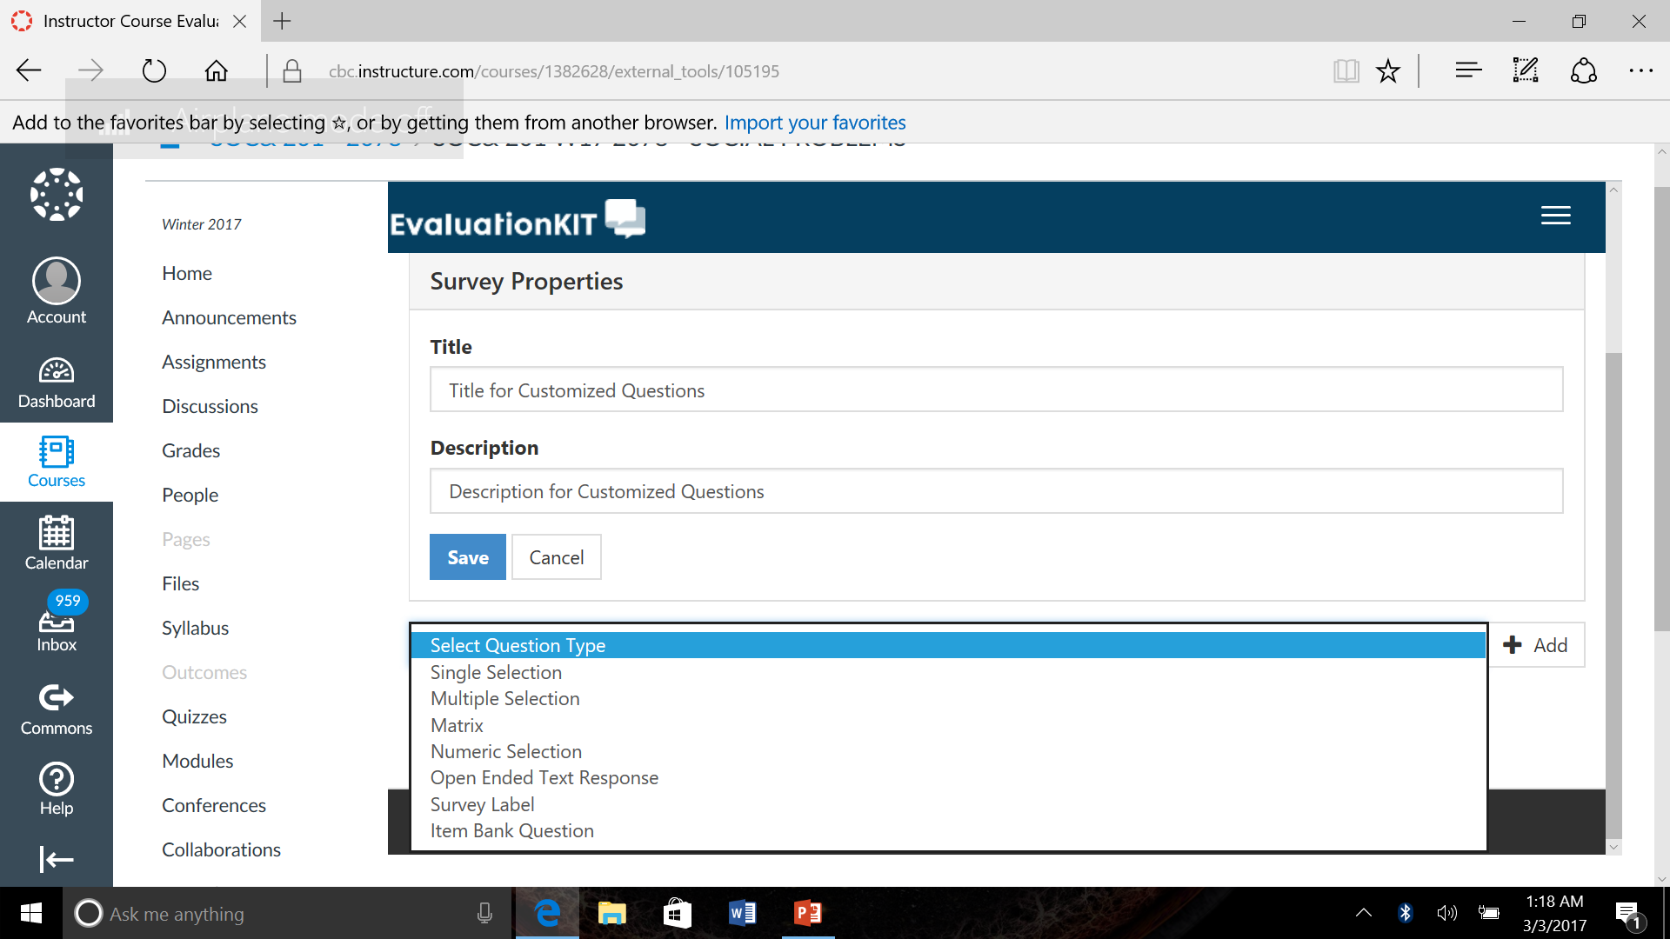
Select a Question Type, then hit “Add”

Slide 10
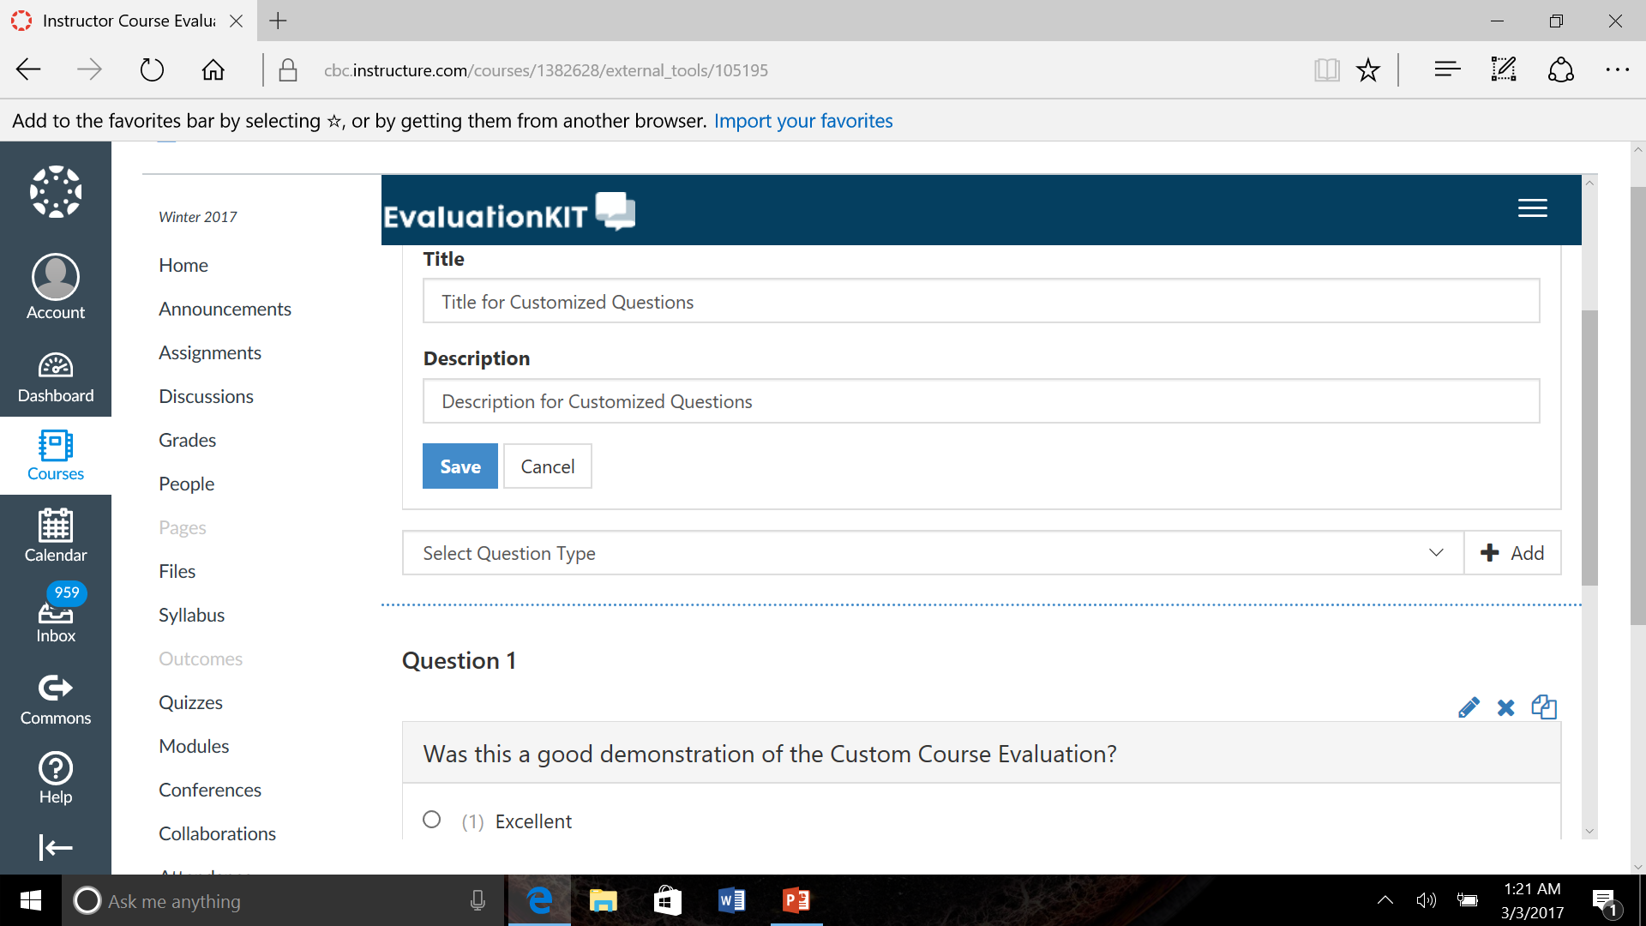
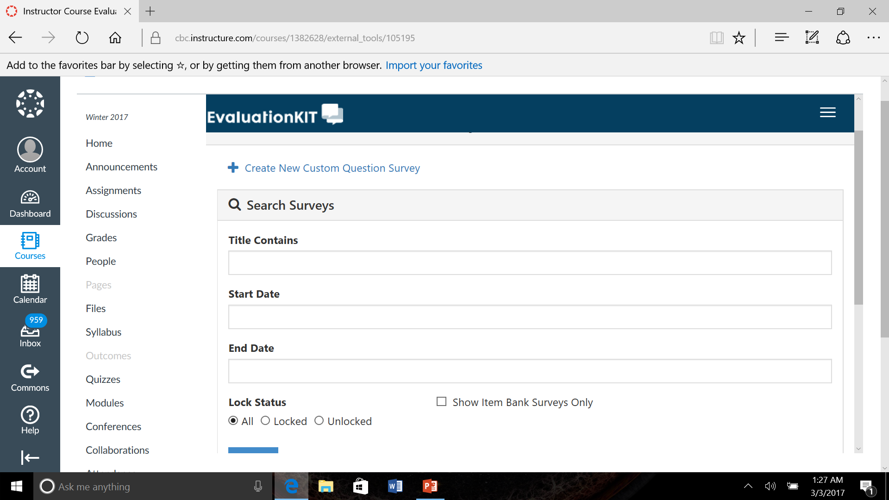
Next, hit “Cancel”.
It will take you to this screen:

Slide 11
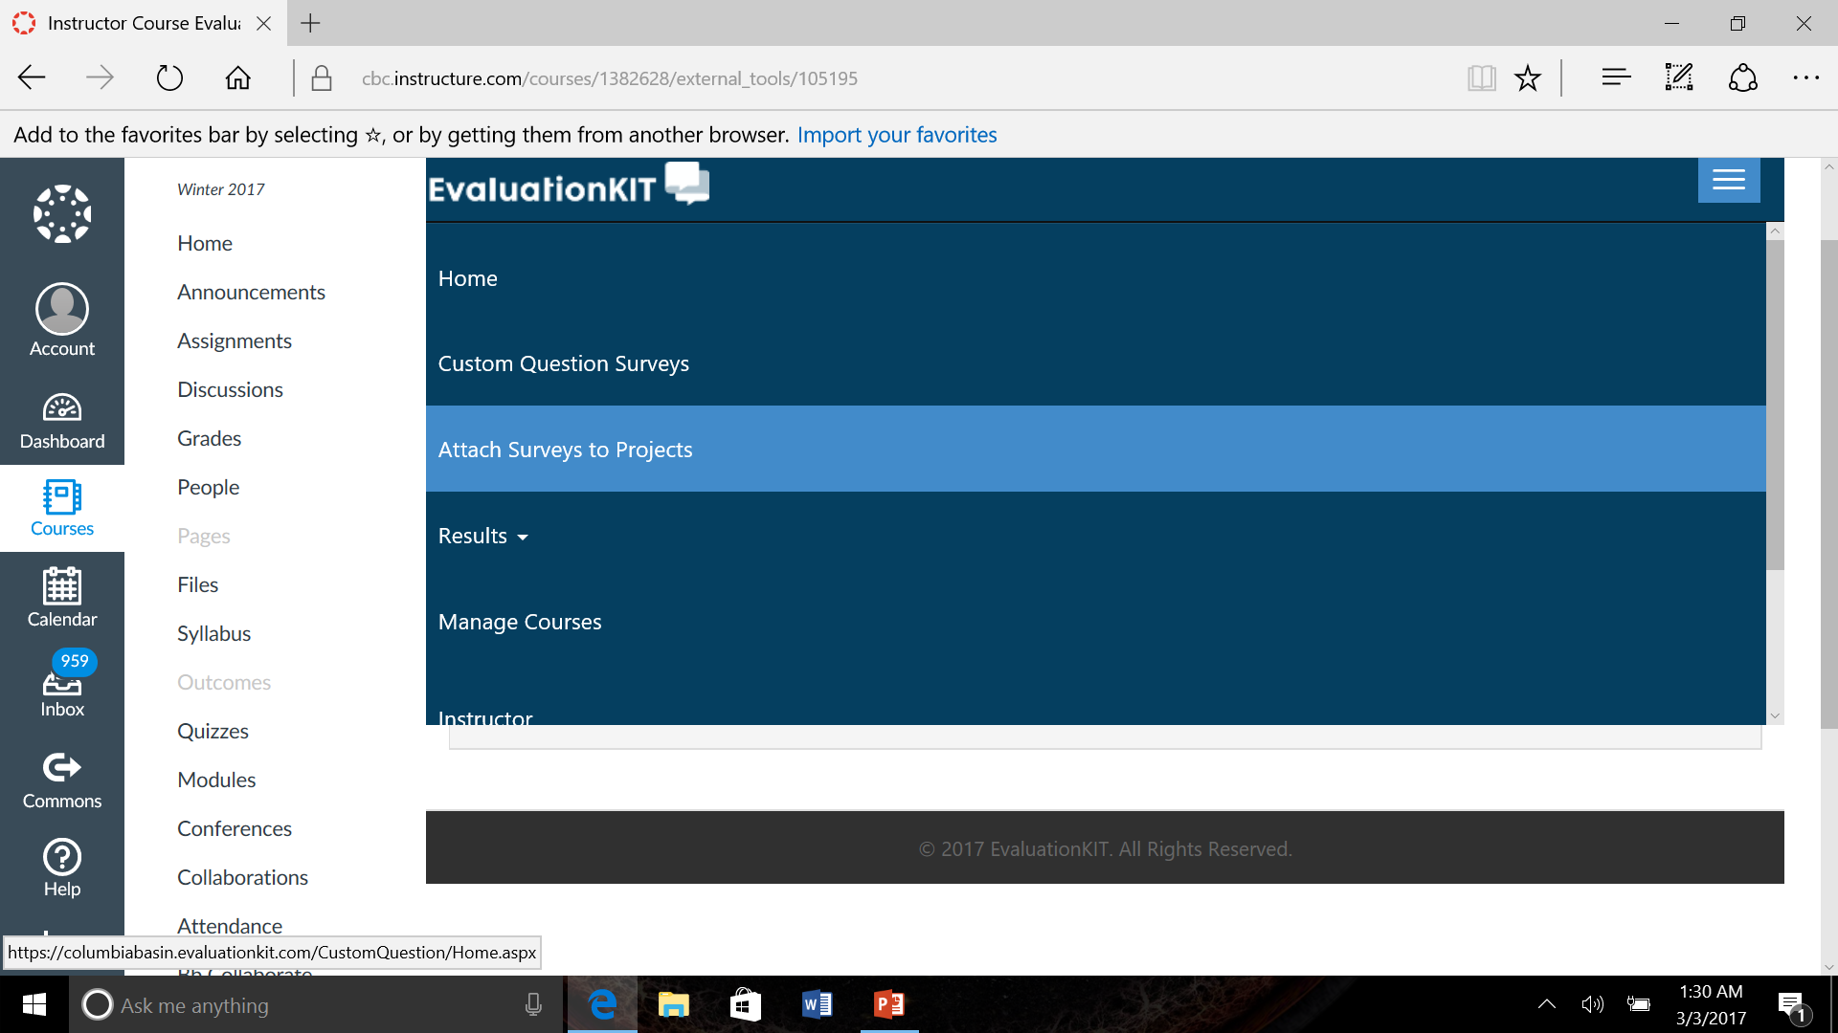
Next, click “Attach Surveys to Projects”

Slide 12
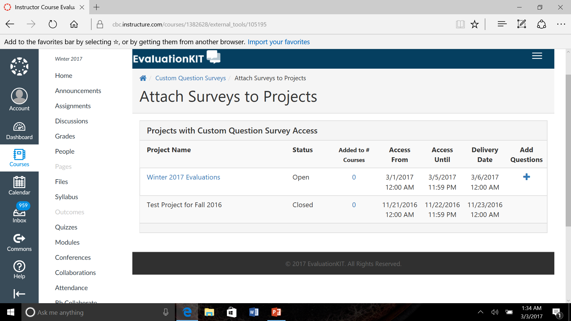
Then, “+” to Add your customized questions

Slide 13
Next, click “Add Custom Question Survey”

Slide 14
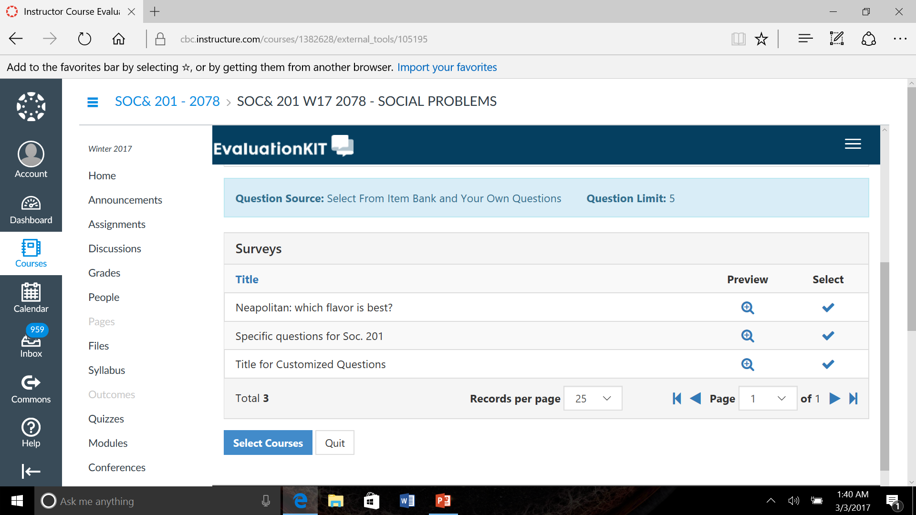
Select which Survey you want to include, then Select the course

Slide 15
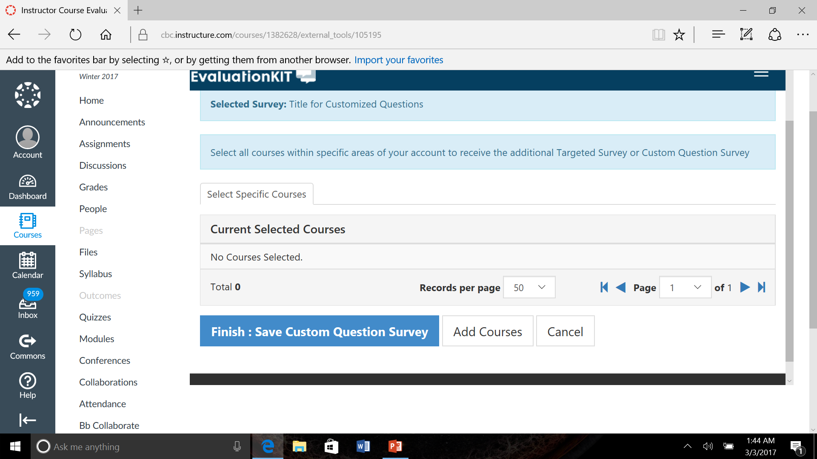
Select “Add Courses”

Slide 16
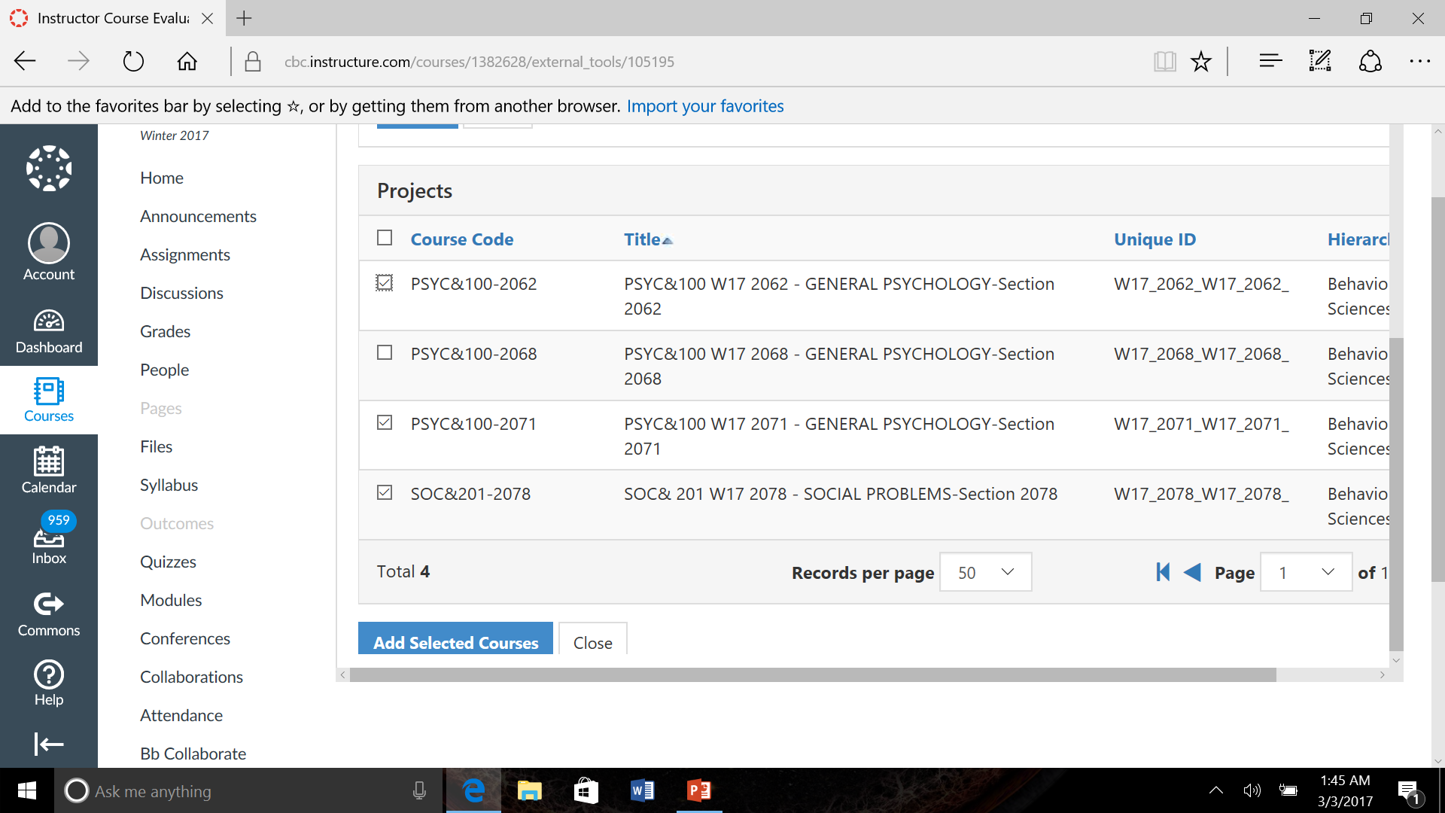
You may select which Courses the Customized Questions will appear in

Slide 17
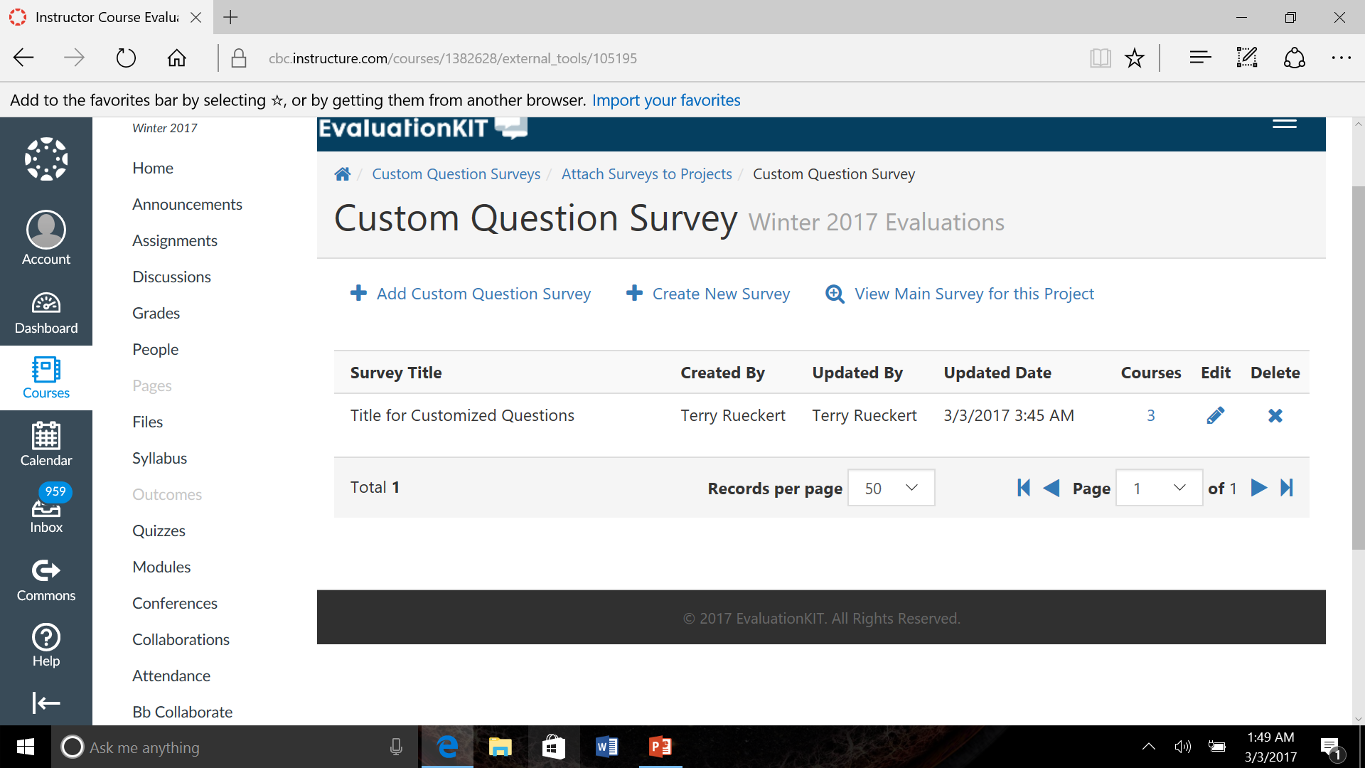
You now may create other Custom Questions if you so choose!

Slide 18
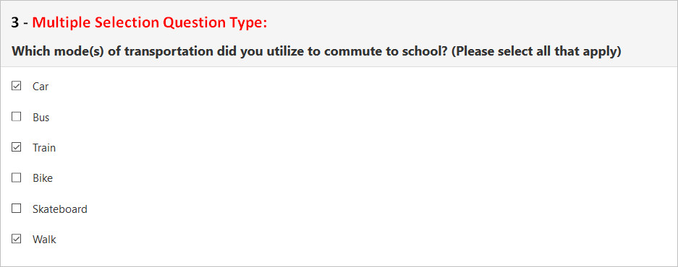
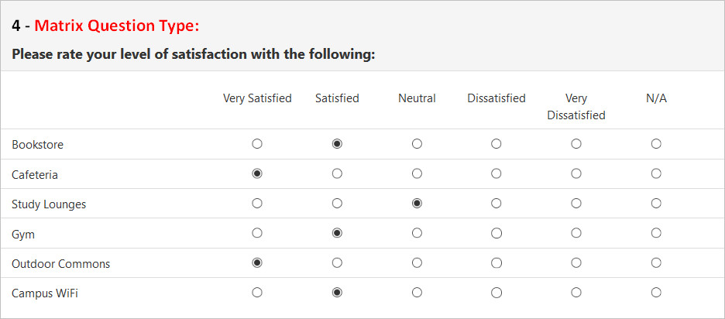
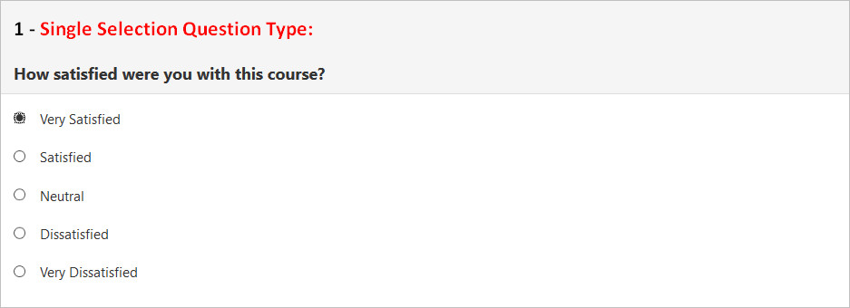
Instructor Help
Survey Builder - Administrators & Instructors (video)
Features a detailed explanation of custom questions features, types of survey questions, and additional properties
Custom Questions for Administrators & Instructors (video)
Features a well-rounded guide on how to start, create, and attach a custom questions survey to the main survey. Also includes a brief description of types of survey questions
Instructor Survey Builder - Types of Survey Questions (article)
A quick reference guide on the types of survey questions:

