Slide 1
Liquids and Solids
Sections 7.8-7.9

Slide 2
The Liquid State
Molecules are much closer together than those of a gas
Stronger IMF than gases, but still weaker than solids
Results in slight mobility of molecules and a more random pattern

Slide 3
Properties of Liquids
Liquids have unique physical properties due to their IMF strength
Vapor pressure
Boiling point
Viscosity
Surface tension

Slide 4
Vapor Pressure
Sometimes molecules from the surface of a liquid vaporize into gaseous molecules before the boiling point temperature
These gaseous molecules
exert a force on the liquid
Inversely related to strength
of IMF
Increases with temperature

Slide 5
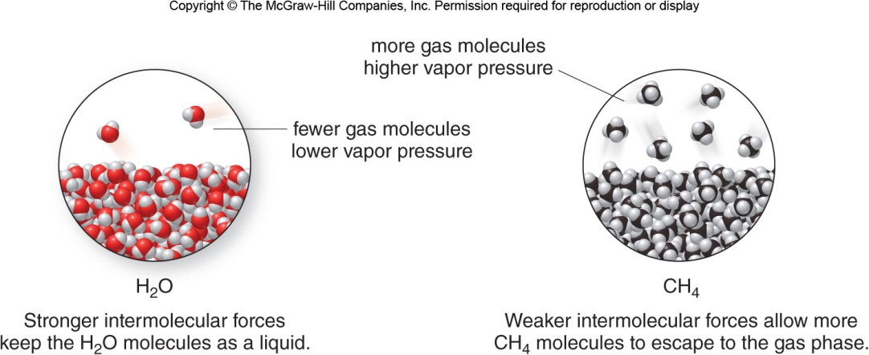
Vapor Pressure

Slide 6
Boiling Point
Temperature at which the vapor pressure of a liquid equals atmospheric pressure
This is why water boils at lower temperatures in places like Denver
Higher elevation means lower atmospheric pressure
Lower atmospheric pressure means lower temperature needed to make vapor pressure equal
Increases with strength of IMF

Slide 7
Example #1
Which molecule in the pair has a higher vapor pressure at a given temperature?
CH₄ or NH₃

Slide 8
Example #1 Solved
Vapor pressure is inversely related to IMF strength
As IMF strength increases the vapor pressure decreases
NH₃ is a polar molecule with H bonded to N so its dominant IMF is H bonding
CH₄ is a nonpolar molecule so its dominant IMF is London dispersion forces
London dispersion forces are weaker, so CH₄ will have a higher vapor pressure at a given temperature

Slide 9
Viscosity
Defined as the “resistance to flow”
Something with a high viscosity is often called a “thick” liquid
For example, molasses is a very viscous liquid
Directly related to IMF strength
As IMF strength increases, viscosity increases
Directly related to size of the molecule
If the molecule is large, the IMF are stronger
Inversely related to temperature
At higher temperatures, the molecules are able to move past one another at a higher rate

Slide 10
Surface Tension
Defined as the “resistance to spread out”
Something with high surface tension will usually bead before spreading out on a surface
Surface tension is directly related to IMF strength
As IMF strength increases, surface tension increases

Slide 11
Example #2
Explain why benzene is less viscous than water, but ethylene glycol is more viscous than water.
H
H
C
H
H
H
C
C
C
O
H
C
O
H
C
C
H
C
H
H
H
H
ethylene glycol
benzene

Slide 12
Example #2 Solved
Water is a polar molecule with H bonded to O (2 times) so its dominant IMF is H bonding
Benzene is a nonpolar molecule, so the dominant IMF is London dispersion forces (weaker than water so less viscous)
Ethylene glycol is a polar molecule with H bonded to O (2 times) so the dominant IMF is H bonding and is larger than water (stronger than water so more viscous)

Slide 13
The Solid State
Molecules are closer together than those of a liquid
Strongest IMF
Results in rigidity of molecules and a more predictable pattern

Slide 14
Properties of Solids
Solids have unique physical properties due to their IMF strength
Melting point
Temperature at which a solid becomes a liquid
Increases with IMF strength

Slide 15
Example #3
Which solid will have the higher melting point?
CO₂(s) or NaCl(s)
H₂O(s) or CO₂(s)
NaCl(s) or CH₃OH(s)

Slide 16
Example #3 Solved
Higher melting point is a result of stronger IMF
CO₂(s) or NaCl(s)
NaCl has ionic IMF, CO₂ has London dispersion forces
H₂O(s) or CO₂(s)
H₂O has H-bonding, CO₂ has London dispersion forces
NaCl(s) or CH₃OH(s)
NaCl has ionic IMF, CH₃OH has H-bonding

Slide 17
Types of Solids
Two major categories
Amorphous- literally “without shape”, random arrangement of particles
Ex. rubber, most plastics
Crystalline- regular arrangement of particles, repeating structure

Slide 18
Crystalline Solids
Several types of crystalline solids
Ionic solid – oppositely charged ions arrange in a lattice pattern, cannot tell one “NaCl” from another
Ionic solids are also known as “salts”

Slide 19
Crystalline Solids
Molecular solid – composed of individual molecules arranged regularly
Molecular solids are covalent compounds

Slide 20
Crystalline Solids
Network solid – very large number of atoms covalently bonded to one another
Form sheets, or 3D arrays
Diamond is an example of a network solid composed entirely of carbon

Slide 21
Crystalline Solids
Metallic solid – a lattice of metal cations surrounded by delocalized electrons
This “sea of electrons” is why metals can conduct electricity

Slide 22
Example #4
Which type of crystalline solid is formed by each substance?
CaS
NH₃
Mg

Slide 23
Example #4 Solved
CaS – ionic compound, therefore ionic solid
NH₃ – covalent compound, therefore molecular solid
Mg – metal, therefore metallic solid

Slide 24
Example #5
Consider the following pair of molecules.
CH₃OH and C₂H₆
Which has the highest:
Vapor pressure
Surface tension
Melting point/Boiling point

Slide 25
Example #6
Which type of crystalline solid is formed by each substance?
benzene, C₆H₆
Magnesium oxide, MgO
Vanadium, V
Diamond, C

