Slide 1
Polarity
Sections 4.7-4.8

Slide 2
Electronegativity
Ability of an atom to attract electrons for a bond
How much an atom “wants” electrons
When atoms share electrons in a covalent bond, the electrons are not always shared equally
Extent of sharing is based on electronegativity values

Slide 3
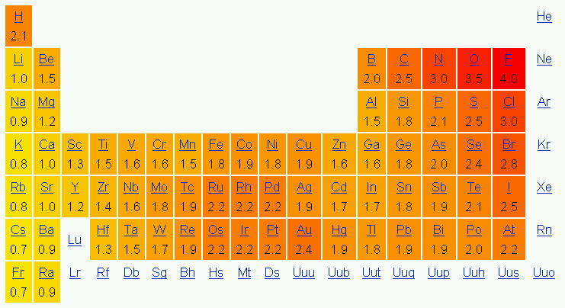
Electronegativity Values
Electronegativity Chart

Slide 4
Example #1
Which type of element higher electronegativity values: metals or nonmetals?

Slide 5
Example #1 Solved
According to the chart of electronegativity values, almost all of the elements on the left have lower electronegativity values. Previously, we covered that the elements on the right (with the exception of H) are metals.
Therefore, the nonmetals have higher EN values.

Slide 6
Bond Polarity
When electrons are not shared equally, the result is a polar covalent bond
Electrons will spend more time around the atom with the higher electronegativity value
This creates a dipole (separation of charge)

Slide 7
Dipoles
To indicate a dipole, we use an arrow going from the less electronegative atom to the more electronegative atom
The symbol δ⁺ indicates the less electronegative atom
The symbol δ⁻ indicates the more electronegative atom
δ⁺
δ⁻
C
O
a dipole

Slide 8
Determining Polarity
Based on difference of electronegativity values of the two atoms in the bond
Look at the two elements involved in the bond
Ex. for HCl the bond is between H and Cl
Subtract one value from another, always should have a positive value
Ex. H is 2.1 and Cl is 3.0
Need to do 3.0-2.1 = 0.9

Slide 9
Types of Bonds
Electronegativity Difference (Δ) | Bond Type | Electron Behavior
Δ < 0.5 | Nonpolar covalent | Electrons equally shared
0.5 ≤ Δ | Polar covalent | Electrons unequally shared, pulled to atom with higher electronegativity
Metal + Nonmetal | Ionic | Electron transfer from metal to nonmetal

Slide 10
Example #2
Classify each bond as nonpolar, polar covalent, or ionic, and draw a dipole arrow if the bond is polar covalent.
Br₂
NaBr
HBr

Slide 11
Example #2 Solved
Br₂ – nonpolar (2.8 - 2.8 = 0)
NaBr – ionic (2.8 – 0.9 = 1.9)
HBr – polar covalent (2.8 – 2.1 = 0.7)
Br is more electronegative
H is less electronegative
H—Br

Slide 12
Bonds Aren’t Everything
While bond polarity is indeed important, we’re more concerned with molecular polarity
This means we have to take all of the bonds in a molecule into account
Draw arrows to depict polarity in a bond, then add them together to determine molecular polarity
Draw towards more EN element

Slide 13
Molecular Polarity
Three cases are possible
A molecule with nonpolar bonds is nonpolar overall
A molecule with only one polar bond is polar overall
A molecule with multiple polar bonds can be polar or nonpolar overall
H
Cl
Net dipole of
the molecule
C
H
C
H
H
H
H
H
Nonpolar bonds
Nonpolar molecule
One polar bonds
Polar molecule

Slide 14
Third Case
A molecule with polar bonds can be nonpolar overall
Based on dipoles for each polar bond in the molecule
Determine if the dipoles cancel or reinforce
Add them up, tip to tail
The two dipoles cancel
O
C
O
No net dipole

Slide 15
Molecular Geometry
Need to know the shape to determine if the dipoles will cancel or reinforce in 3D space
Example: H₂O
If drawn linear: dipoles cancel
If drawn correctly:
H
O
H
H
net dipole
O
H

Slide 16
Polar/Nonpolar Molecules
net dipole
net dipole
O
F
Cl
N
H
C
B
H
C
Cl
H
H
F
F
H
H
H
one polar bond
three polar bonds
all dipoles cancel
no net dipole
three polar bonds
dipoles reinforce
two polar bonds
dipoles reinforce
polar molecule
nonpolar molecule
polar molecule
polar molecule

Slide 17
Example #3
Determine whether each molecule is polar or nonpolar.
CS₂
CH₃COOH
HCN

Slide 18
Example #3 Solved
CS₂: bond polarity (EN values) C-S 2.5-2.5 = 0
nonpolar bonds therefore nonpolar
CH₃COOH: bond polarity C-H 2.5-2.1 = 0.4 nonpolar
C-C 2.5-2.5 = 0 nonpolar
O-C 3.5-2.5 = 1 polar
O-H 3.5-2.1 = 1.4 polar
dipoles reinforce therefore polar
HCN: bond polarity C-H 2.5-2.1 = 0.4 nonpolar
N-C 3.0-2.5 = 0.5 polar
dipoles reinforce therefore polar
S
C
S
O
H
C
C
H
H
O
H
H
C
N

Slide 19
Example #4
Which of the following bonds are polar?
Li-N
C-S
P-H
C-H
O-K
Cl-As

Slide 20
Example #5
Draw a dipole arrow for any polar bond.
B
C
C
Li
C
Cl

Slide 21
Example #6
Label the polar bonds in each molecule and then decide if the molecule is polar or nonpolar.
HCl
C₂H₆
CH₂F₂
CCl₄

