Slide 1
Periodic Trends
Section 2.8

Slide 2
Trends
Some properties change in a regular way across and period and down a group
We’ll look at three properties
Atomic size
Ionization energy
Electronegativity

Slide 3
Atomic Size
Distance from the nucleus to the outermost electron
As one goes down a group, the number of shells increases, so the distance from the outermost electron to the nucleus increases
Therefore the atomic size increases down a group
As one goes from left to right across a period, the largest shell doesn’t change, but the number of protons in the nucleus increases, so those outermost electrons are pulled in tighter
Therefore the atomic size decreases across a period

Slide 4
Atomic Size
1 18
2 13 14 15 16 17
1
2
3
4
5
6
7

Slide 5
Example #1
Rank the atoms in each group in order of increasing size:
silicon, sulfur, magnesium
krypton, neon, xenon
boron, carbon, neon

Slide 6
Example #1 Solved
Si, S, Mg: all in period 3, size decreases from left to right therefore S < Si < Mg
Kr, Ne, Xe: all in group 18, size increases down a group therefore Ne < Kr < Xe
B, C, Ne: all in period 2, size decreases from left to right therefore Ne < C < B

Slide 7
Ionization Energy
Energy needed to remove the outermost electron from a neutral atom
As one goes down a group, the number of shells increases, so the outermost electrons are held less tight so it takes less energy to remove it
The ionization energy decreases down a group
As one goes from left to right across a period, the largest shell doesn’t change, the outermost electron is pulled in tighter, so it takes more energy to remove it
The ionization energy increases across a period

Slide 8
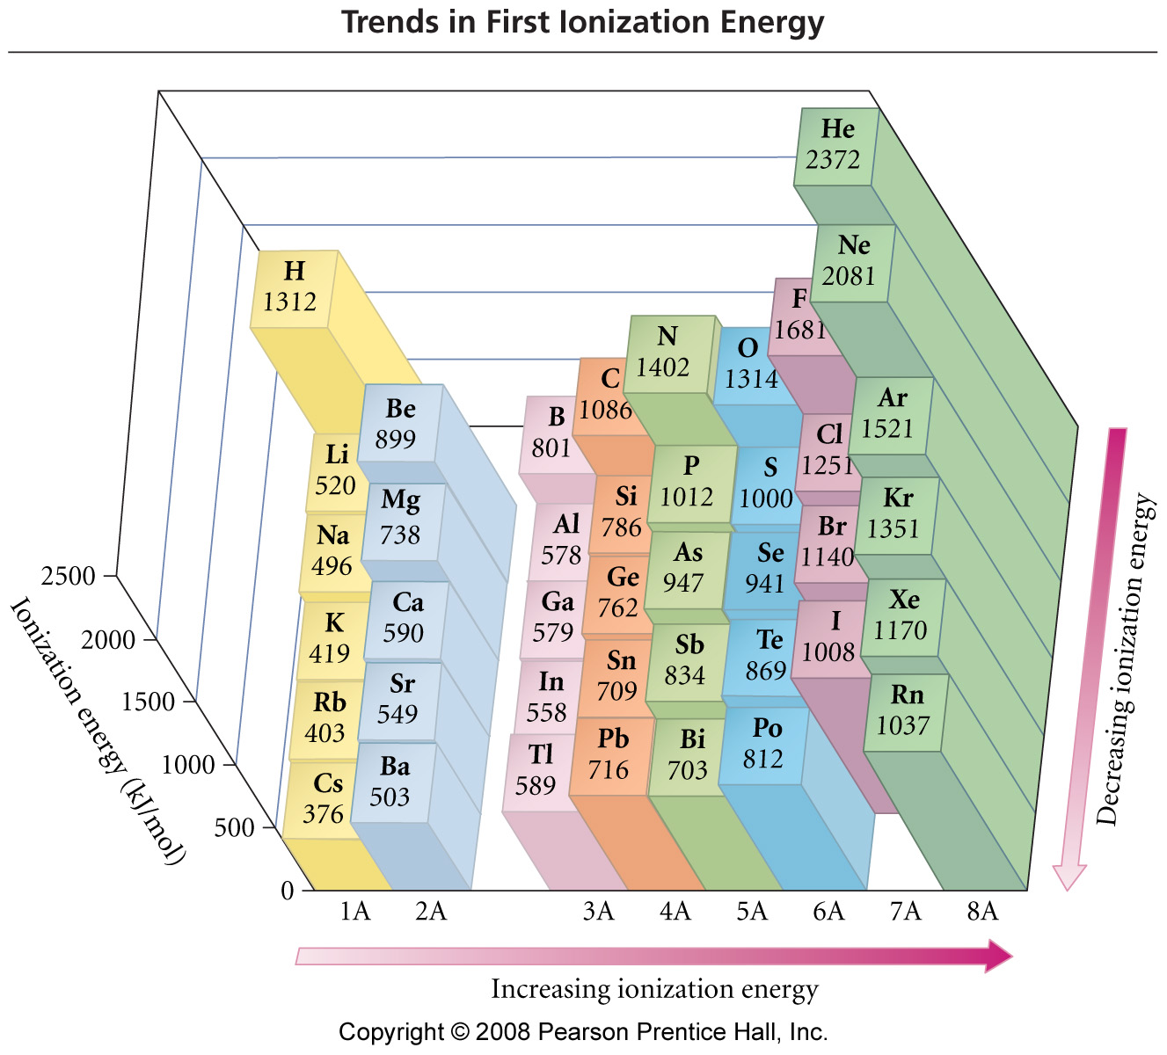
Ionization Energy
From Prentice Hall

Slide 9
Example #2
Rank the atoms in each group in order of increasing ionization energy:
phosphorus, silicon, sulfur
tin, silicon, sulfur
calcium, aluminum, nitrogen

Slide 10
Example #2 Solved
P, Si, S: all in period 2, ionization energy increases from left to right therefore Si < P < S
Sn, Si, S: S furthest up and right, Si above Sn therefore Sn < Si < S
Ca, Al, N: N furthest up and right, then Al, the Ca therefore Ca < Al < N

Slide 11
Electronegativity
Ability of an atom to attract another atom’s electrons
As one goes down a group, the number of shells increases, so other atoms can’t feel the proton pull as much
The electronegativity decreases down a group
As one goes from left to right across a period, the largest shell doesn’t change, so other atoms feel the proton pull stronger
The electronegativity increases across a period

Slide 12
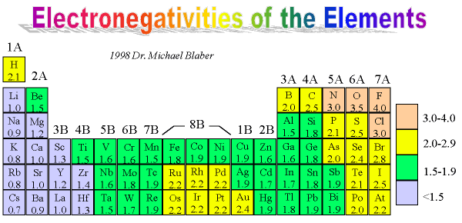
Electronegativity
From Mike Blaber, Ph.D.

Slide 13
Example #3
Select the atom with the higher electronegativity out of the pair:
hydrogen and carbon
fluorine and francium
calcium and oxygen
chlorine and sulfur

Slide 14
Example #3 Solved
hydrogen and carbon
carbon is further to the right
fluorine and francium
fluorine is further to the right and higher up
calcium and oxygen
oxygen is further to the right and higher up
chlorine and sulfur
chlorine is further to the right

Slide 15
Example #4
List the following atoms in decreasing order for the given property:
Ionization energy: neon, krypton, argon
Electronegativity: boron, carbon, nitrogen
Atomic size: fluorine, sulfur, aluminum

Slide 16
Example #5
List the following atoms in increasing order for the given property:
Electronegativity: oxygen, sodium, phosphorus
Atomic size: calcium, magnesium, beryllium
Ionization energy: carbon, fluorine, beryllium

