Slide 1
Electrons
Sections 2.5-2.7

Slide 2
Electrons
energy levels
Chemical properties are determined by the electrons
Not randomly dispersed in the cloud
Cloud contains discrete energy levels (or shells) which contain a specific number of electrons
32
18
8
2
+
nucleus

Slide 3
Address Analogy
If you think of electrons as people, you can locate the electron using an address
Start with least specific information, the shell
“city part” of the address
Next is more specific, the subshell
“street part” of address
Dependent on city number
More specific still, the orbital
“house part” of address
Dependent on street letter
Each orbital holds a maximum of two electrons
Two people per house

Slide 4
Shells (n)
Also known as energy levels
Numbered n = 1, 2, 3, etc.
Roughly correspond to periods in periodic table
Lower “n” shells are smaller, thus hold fewer electrons
Electrons in lower “n” shells are closer to the nucleus
Held more tightly
Have lower energy

Slide 5
Subshells
Energy shells are divided into subshells
Use letters s, p, d, and f
Always in that order, s is lowest in energy
Number of subshells depends on “n”
Subshells become more complicated as they increase in energy
City: 3 Street: d
City: 2 Street: p
City: 3 Street: p
City: 1 Street: s
City: 2 Street: s
City: 3 Street: s

Slide 6
Orbitals
An orbital is a region of space where it is statistically probable to find electrons
Each orbital holds a maximum of two electrons
A particular type of subshell contains a specific number of orbitals
Street: d
5 houses
Street: p
Street: p
3 houses
3 houses
Street: s
Street: s
Street: s
1 house
1 house
1 house

Slide 7
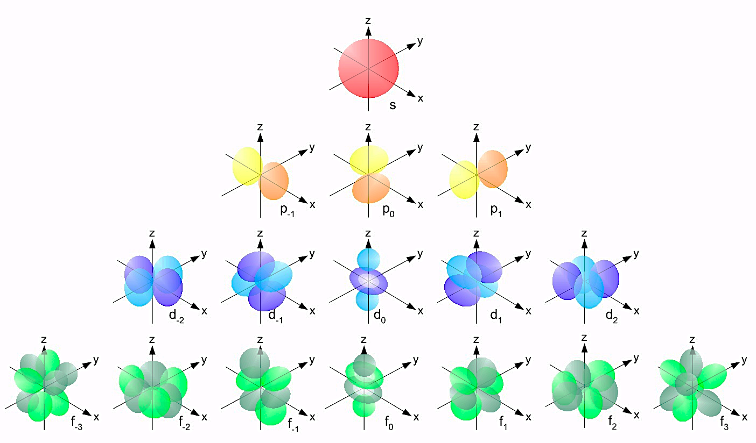
Orbital Shapes
s
p
d

Slide 8
Electrons
Electrons are located inside orbitals, in a subshell, in a shell
There is a maximum of two electrons per orbital
Street: d
2
2
2
2
2
5 houses
Street: p
Street: p
2
2
2
2
2
2
3 houses
3 houses
Street: s
Street: s
Street: s
2
2
2
1 house
1 house
1 house

Slide 9
Summary
Shell “city” | Subshell “street” | Orbitals “houses” | Electron “people” | Max Electrons in shell
1 | s | 1 | 2 | 2
2 | s | 1 | 2 | 8
 | p | 3 | 6
3 | s | 1 | 2 | 18
 | p | 3 | 6
 | d | 5 | 10
4 | s | 1 | 2 | 32
 | p | 3 | 6
 | d | 5 | 10
 | f | 7 | 14

Slide 10
Example #1
How many electrons are in each of the following shells/subshells?
4f
n = 3
2p
n = 1
3d
5s

Slide 11
Example #1 Solved
4f – f subshell contains 14 electrons
n = 3 – shell 3 contains 18 electrons
2 from 3s, 6 from 3p, and 10 from 3d
2p – p subshell contains 6 electrons
n = 1 – shell 1 contains 2 electrons
2 from 1s
3d – d subshell contains 10 electrons
5s – s subshell contains 2 electrons

Slide 12
Orbital Diagram
How all of the electrons in an atom are arranged
Can draw a diagram for each element
Begin with the lowest energy electrons and work themselves up
Always in the same order
Will look very similar to address figure with houses, except instead of boxes, we will use lines

Slide 13
Order of Orbitals
6d __ __ __ __ __
5f __ __ __ __ __ __ __
7s __
6p __ __ __
5d __ __ __ __ __
4f __ __ __ __ __ __ __
6s __
5p __ __ __
4d __ __ __ __ __
5s __
4p __ __ __
3d __ __ __ __ __
4s __
3p __ __ __
3s __
2p __ __ __
2s __
1s __
1s
2s 2p
3s 3p 3d
4s 4p 4d 4f
5s 5p 5d 5f
6s 6p 6d
7s 7p
Increasing Energy

Slide 14
Filling Orbitals
Number of electrons = atomic number
Always start will lowest energy orbital
Only two electrons fit in an orbital, and they must be opposite spins
Electrons are depicted by arrows, either up or down
__
If subshell contains more than one orbital, must half-fill all orbitals in subshell before fully filling any orbital
__ __ __ not __ __ __

Slide 15
Example #2
Draw an orbital diagram for hydrogen (H), beryllium (Be), and fluorine (F).

Slide 16
Example #2 Solved
H: Z = 1 Be: Z = 4 F: Z = 9
1 e⁻ 4 e⁻ 9 e⁻
2p__ __ __
2s__ 2s__
1s__ 1s__ 1s__

Slide 17
Electron Configuration
Another way to show information from orbital diagram
Lists energy level, subshell, and number of electrons in subshell
1s²2s²2p⁴
Add up the number of electrons and you’ll find Z
From example above: 2 + 2 + 4 = 8, Z = 8: oxygen
Remember, subshells have an electron limit (see slide 9)

Slide 18
Written Out Order
Same as orbital order
This order is built into the periodic table, read periodic table as though it were a book, L to R
1s
1s
1s
2s
2p
3s
3p
4s
3d
4p
5s
4d
5p
6s
5d
6p
7s
6d
7p
4f
5f

Slide 19
How to Write
s¹ s²
p¹ p² p³ p⁴ p⁵ p⁶
Start here
1s
1s
2s
2p
End here for Cl
3s
d¹ d² d³ d⁴ d⁵ d⁶ d⁷ d⁸ d⁹ d¹⁰
3p
Cl
4s
3d
4p
5s
4d
5p
6s
5d
6p
7s
6d
7p
4f
5f
chlorine (Cl): 1s²2s²2p⁶3s²3p⁵

Slide 20
Example #3
Write the electron configuration for the following elements:
Calcium (Ca)
Bromine (Br)
Nitrogen (N)
Antimony (Sb)
Rubidium (Rb)
Iron (Fe)

Slide 21
Example #3 Solved
c.
a.
f.
b.
e.
d.

Slide 22
Example #3 Solved
Ca: 1s²2s²2p⁶3s²3p⁶4s²
Br: 1s²2s²2p⁶3s²3p⁶4s²3d¹⁰4p⁵
N: 1s²2s²2p³
Sb: 1s²2s²2p⁶3s²3p⁶4s²3d¹⁰4p⁶5s²4d¹⁰5p³
Rb: 1s²2s²2p⁶3s²3p⁶4s²3d¹⁰4p⁶5s¹
Fe: 1s²2s²2p⁶3s²3p⁶4s²3d⁶

Slide 23
Shorthand
Based on the idea of “full shells”
Each full row is a full shell (end in group 18 with noble gases)
Shorthand notation is also called noble gas notation
Calcium goes from 1s²2s²2p⁶3s²3p⁶4s² to [Ar]4s²
Argon (Ar) is the last noble gas before Calcium
Its electron configuration is 1s²2s²2p⁶3s²3p⁶
1s²2s²2p⁶3s²3p⁶4s² and [Ar]4s² are the same

Slide 24
Example #4
Write out the shorthand notations for the other 5 elements from example 3.
Bromine (Br)
Nitrogen (N)
Antimony (Sb)
Rubidium (Rb)
Iron (Fe)

Slide 25
Example #4 Solved
Br: 1s²2s²2p⁶3s²3p⁶4s²3d¹⁰4p⁵ is [Ar] 4s²3d¹⁰4p⁵
N: 1s²2s²2p³ is [He] 2s²2p³
Sb: [Kr] 5s²4d¹⁰5p³
Rb: [Kr] 5s¹
Fe: [Ar] 4s²3d⁶

Slide 26
Types of Electrons
There are two types of electrons in an atom
Inner, or core, electrons and valence electrons
Inner electrons are those which are designated by the noble gas in the noble gas shorthand
Using calcium as an example:
[Ar]4s²
1s²2s²2p⁶3s²3p⁶4s²
Inner electrons do not contribute to chemical properties, only to size

Slide 27
Valence Electrons
Outermost electrons in an atom
Have the most interaction with other atoms
Responsible for the chemical properties of an element
Have the highest “n” value
Are in “s” and “p” orbitals
Valence electron
Rest are inner electrons

Slide 28
Valence Electrons
Looking again at calcium
1s²2s²2p⁶3s²3p⁶4s²
4 is the highest “n” value
There are 2 electrons in the s orbital and none in the p orbital so there are 2 valence electrons for calcium

Slide 29
Valence Electrons
Let’s look at electron configurations and identify the valence electrons
Br: 1s²2s²2p⁶3s²3p⁶4s²3d¹⁰4p⁵ 2+5=7 valence e⁻
Sb: [Kr]5s²4d¹⁰5p³ 2+3=5 valence e⁻
N: 1s²2s²2p³ 2+3=5 valence e⁻
Fe: [Ar]4s²3d⁶ 2 valence e⁻
Rb: 1s²2s²2p⁶3s²3p⁶4s²3d¹⁰4p⁶5s¹ 1 valence e⁻

Slide 30
Some Connections
There is a correlation between group number and number of valence electrons
Let’s revisit the 6 elements: Ca, Br, Sb, N, Rb, Fe
Put in order of group number
Rb: group 1 – 1 valence electron
Ca: group 2 – 2 valence electrons
Fe: group 8 – 2 valence electrons
N: group 15 – 5 valence electron
Sb: group 15 – 5 valence electrons
Br: group 17 – 7 valence electrons

Slide 31
Valence Electrons
Groups 1 has 1 valence electron
Group 2 has 2 valence electrons
Groups 3-12 have only 2 valence electrons
do not count the “d” electrons, they have a lower “n”
Group 13 has 3 valence electrons
Group 14 has 4 valence electrons
Group 15 has 5 valence electrons
Group 16 has 6 valence electrons
Group 17 has 7 valence electrons
Group 18 has 8 valence electrons

Slide 32
Valence Electrons
Elements in a group have similar chemical properties because they have the same number of valence electrons
They will interact with other atoms in a similar manner
Fluorine (F) and chlorine (Cl) are both in group 17 so they both have 7 valence electrons
They have very similar chemical properties

Slide 33
Example #5
How many valence electrons do the following elements have?
Carbon (C)
Sodium (Na)
Nickel (Ni)
Phosphorus (P)

Slide 34
Example #5 Solved
C: 1s²2s²2p² group 14
4 valence electrons
Na: 1s²2s²2p⁶3s¹ group 1
1 valence electron
Ni: 1s²2s²2p⁶3s²3p⁶4s²3d⁸ group 10
2 valence electrons
P: 1s²2s²2p⁶3s²3p⁶4s²3d¹⁰4p³ group 15
5 valence electrons

Slide 35
Electron Dot Symbols
Number of valence electrons around symbol
One dot on each side first then you can pair the dots
H C O Cl
Number of valence electrons: 1 4 6 7
Electron dot symbol H C O Cl

Slide 36
Electron Dot Symbols
Doesn’t matter which side you start on
N N N N

Slide 37
Example #6
Draw the electron dot symbols for sulfur and phosphorus.

Slide 38
Example #6 Solved
The symbol for sulfur is S. S is in group 16 and has six valence electrons.
Electron dot symbol:
The symbol for phosphorus is P. P is in group 15 and has five valence electrons.
Electron dot symbol:
S
P

Slide 39
Example #7
For the following elements determine the following:
Element Symbol
Group #
Period #
Atomic #
Atomic Mass
Number of Protons
Number of Electrons
Number of Valence Electrons
Orbital diagram
Electronic configuration
Electronic configuration in shorthand
Carbon
Nickel
Strontium
Antimony
Zinc
Fluorine

